Slide 1
Fiscal Policy
Using Taxation and Government spending to manage the nation’s economy

Slide 2
Fiscal Policy
Government decisions on spending and taxation that are intended to improve or maintain the economy by increasing or decreasing the money supply.
Because the government is so large and has such an impact on business, the decisions it makes has a HUGE influence on the economy.

Slide 3
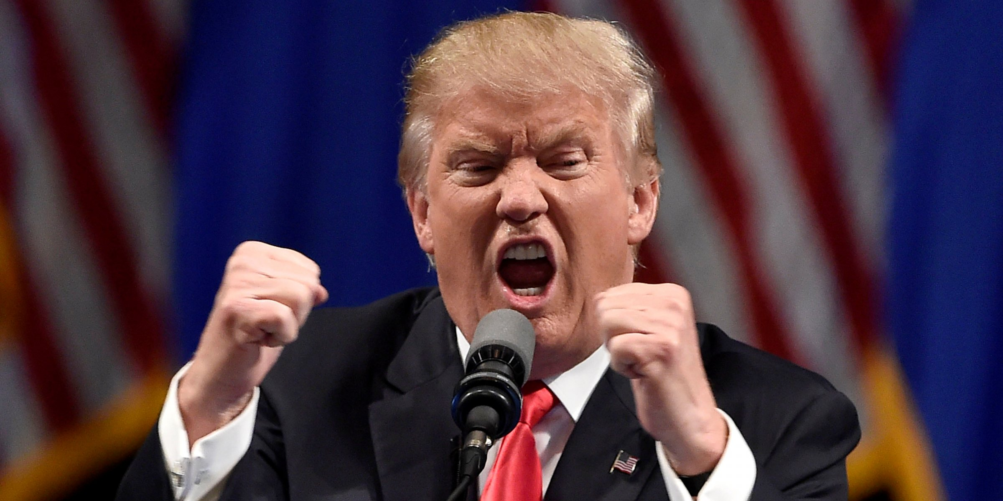
Who makes Fiscal Policy?
Congress and the President make fiscal policy through the federal budget.
The Fed DOES NOT make fiscal policy.

Slide 4
Federal Budget
Written document that indicates amount of money the government expects to receive from taxes and other revenue for a specific year
and
Authorizes the amount of money the government can spend that year.
Every Fiscal Year the government makes a new budget.

Slide 5
Fiscal Policy and the Economy
The total level of government spending can be changed to help increase or decrease the output of the economy.
Expansionary Fiscal Policy:
Policies that attempt to increase the output of the economy to create jobs and increase the tax base.
Contractionary Fiscal Policy:
Policies that try to decrease the output of the economy to slow down inflation and prevent economic recessions.

Slide 6
Expansionary Fiscal Policy
During a contraction or recession, the government can do two things to increase output:
Decrease Taxes
and / or
Increase Spending

Slide 7
Decreasing Taxes…
(and using Debt to pay for it)
Increases Money Supply
Gives people more money to spend
More money = more demand
More demand = more production
More production = more jobs
More jobs = more demand etc. etc.

Slide 8
Increase Government Spending…
(and using Debt to pay for it)
Increases Money supply
Increases demand for goods
More demand = more production
More production = more jobs
More jobs = more demand etc. etc.

Slide 9
Contractionary Policies
During a period of excessive inflation (during a period of expansion), the government can do two things:
Increase Taxes
And / Or
Decrease Spending

Slide 10
Increase Taxes
People have less money to spend
Less money = less demand
Less demand = lower inflation
Extra $$ to Government can be used to pay off debt.
Lower GDP and Higher Unemployment.

Slide 11
Decrease Spending
Less money in economy
Less money = less demand
Less demand = lower inflation
Also results in lower output and higher unemployment rate.

Slide 12
Austerity
Increase Taxes
01
Cut Government Spending
02
Pay Down Debt
03

Slide 13
Which party favors which Contractionary policy?
Trick Question! Neither party favors Contractionary Fiscal Policies!!!
This is one of the problems with Fiscal Policy

Slide 14
Problem with Fiscal Policy
It is unpopular to raise taxes or cut spending.
Elected officials rarely do either, and they never include it in their campaign platform.
Ex. In 1984, Walter Mondale ran for president saying a slight tax increase would help equalize the U.S. economy. Ronald Regan defeated him in one of the biggest landslides in U.S. history!

Slide 15
Problems with Fiscal Policy
If the government cuts taxes, they have less money to spend or they go into debt.
The federal debt is in the trillions of dollars, so the government has to borrow money by selling bonds. These bonds have to be paid back with interest, costing the government more money!

Slide 16
Deficit vs Debt
What is the Difference?
Federal Budget Deficit:
National Debt:

Slide 17
Regressive Tax
Takes larger percentage of income from people with low incomes
Example = sales tax
Example: Brian makes $100,000/year, Jill makes $50,000/year
Sales tax of 5%
Both Brian and Jill buy a new Jet Ski that retails for $10,000→ x 5% sales tax = $10,500
Total sales tax paid = $500
That $500 represents a larger percentage of Jill’s income (1%) than Brian’s Income (0.5%)

Slide 18
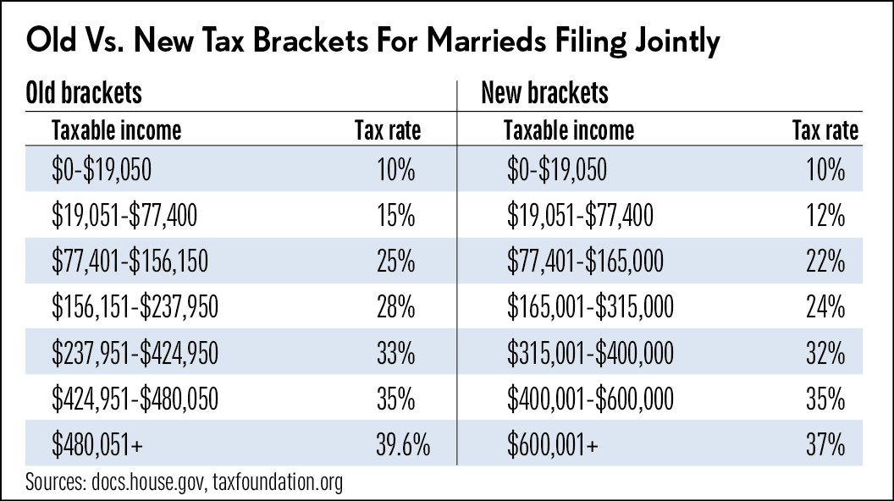
Progressive Tax
Takes a larger percentage of income from higher-earning people
Example: Federal Income Tax

Slide 19
Proportional Tax
A.K.A. Flat Taxes
Takes the same percentage of income from individuals at all levels
Sam makes $100,000/year and pays 5% tax rate ($5000)
Sarah makes $50,000/year and also pays 5% tax rate ($2500)
Sam pays more $$, but same proportion of income.

Slide 20
Other Types of Taxes
Sales Tax
Tax assigned to the purchase of most consumer G & S
Excise Tax
Tax on manufacture, sale, or consumption of a particular good or service
Ex. Alcohol, tobacco, firearms
Estate Tax
Tax paid on the assets of someone who has died
Income Tax
Taxes taken out of a person’s income
Largest source of revenue for state governments
Property Tax
Taxes on houses, factory buildings, hotels, and the land on which they were built
Largest source of income for local governments

