Slide 1
US History
Unit 2: Revolution and US Constitution

Slide 2
SSUSH3: Analyze the Causes of the American Revolution
Explain how the French and Indian War and the 1763 Treaty of Paris lay the groundwork for the American Revolution
Explain colonial response to the Proclamation of 1763, stamp act, and intolerable acts as seen in the sons and daughters of liberty and the committees of correspondence.
Explain the importance of Thomas Paine’s Common Sense to the movement for independence.

Slide 3
French and Indian War (1754-1763)
North American part of a larger worldwide conflict
Great Britain & Indian Allies vs France & Indian Allies
Fought for control of disputed lands in Ohio River Valley.
French were using for fur trade, England wanted to expand.
Great Britain eventually won the war

Slide 4
Treaty of Paris 1763
Great Britain got all of Canada and all land east of the Mississippi River, with the exception of the city of New Orleans.
Great Britain traded Cuba to the Spanish for Florida, ending Spanish threats on the Atlantic Seaboard.
Spain also got all lands west of the Mississippi River
France got to keep a few Caribbean islands and fishing rights near Newfoundland.

Slide 5
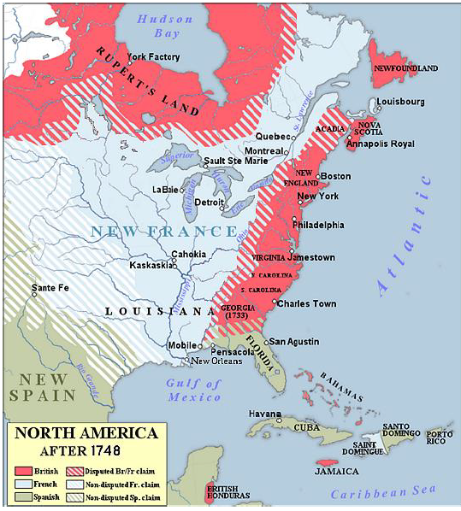
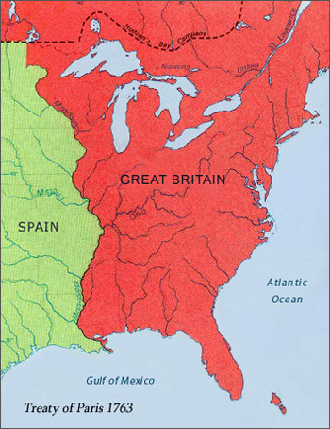
Treaty of Paris 1763

Slide 6
Proclamation of 1763
After the war, colonists began to pour over the Appalachian Mountains in search of land.
English Colonists were attacked by hostile natives who got along with France, but hated Britain. (Chief Pontiac)
Great Britain couldn’t afford another war and couldn’t protect colonists westward movement.
To keep peace, England established proclamation line to separate colonists and natives.

Slide 7
Stamp Act
required the colonists to print newspapers, legal documents, playing cards, etc. on paper bearing special stamps.
Buying the stamped paper was the equivalent of paying a tax.
Previous taxes had only impacted certain groups, such as molasses importers, but the Stamp Act affected everyone in colonial America.
Committee of Correspondence formed to efficiently communicate with the other colonies on matters of concern.
Stamp Act Congress drafted formal petitions of protest to Parliament.
Sons of Liberty - Boston, Samuel Adams organized to protest the law.

Slide 8
Stamp Act
Protests often turned violent.
Tax collectors hung in effigy and their property destroyed.
Ships carrying stamps were denied entry to colonial ports.
New York merchants organized a boycott of British goods, which spread to other colonies and had a huge impact on British importers.
rising tide of violence in the colonies and the economic effects of boycotts resulted in the repeal of the Stamp Act in March 1766.
The hated law was largely ignored and barely lasted a year.
Declaratory Act – GB can tax colonies

Slide 9
Intolerable Acts
Designed to punish and make an example of Massachusetts and to quell the growing resistance to British authority throughout the colonies, Parliament passed a series of laws:
Boston Port closed until the value of the destroyed tea was repaid
Massachusetts colonial government suspended and placed directly under the control of the royal governor appointed by the king
British officials accused of crimes would be tried in England rather than in Massachusetts
Renewed the Quartering Act of soldiers in the colonies
Quebec Act expanded the border of Quebec into land claimed by other colonies

Slide 10
Intolerable Acts
Acts did not force Massachusetts into submission
Colonists believed that Parliament had once again acted outside the English Constitution and violated the civil rights of the British citizens living in America.
The experience of Massachusetts could easily be the experience of other colonies.
effectively unified the colonies to work as a group against the British government.

Slide 11
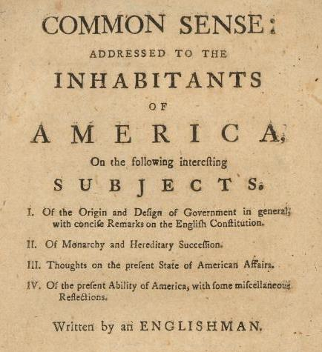
Thomas Paine’s Common Sense
Published anonymously by Thomas Paine in January 1776
Either read or heard by almost every American colonist.
Clearly worded rationale for independence that the common man could understand.
Paine’s argument helped to persuade many colonists who were undecided to support the cause of independence.

Slide 12
Thomas Paine’s Common Sense
The title was intended to make people think about the absurdity of a large continent (America) being controlled by a small island (England).
Why would they remain loyal to a corrupt king whose laws were unreasonable.
Prior to Common Sense’s most colonists blamed Parliament for their unfavorable situation – not the king.
Paine shifted the blame from Parliament to King George III.
He urged reluctant colonists to follow the course of independence through his blunt prose written in the vernacular of the time.
A famous line from the fifty-page pamphlet is, “tis time to part.”

Slide 13
SSUSH4: Ideological, Military, Social, and Diplomatic Aspects of the American Revolution
Investigate intellectual sources, organization, and argument of the Declaration of Independence
Explain the reason for, and the significance of Alliance with the French and other foreign assistance and Diplomacy
Analyze George Washington as a Military Leader.
Investigate the role of Geography at the battles of Trenton, Saratoga, and Yorktown
Examine the roles of Women, Indians, slaves and free blacks in supporting the war effort
Explain the significance of the Treaty of Paris 1783

Slide 14
Declaration of Independence
Thomas Jefferson was the principal author
Committee of Five selected to draft a statement to represent the Continental Congress’s decision to seek independence.
  Thomas Jefferson
  Benjamin Franklin
  John Adams
  Robert Livingston of New York
  Roger Sherman of Connecticut
Congress voted to break from British control on July 2, 1776.
Formally adopted Declaration of Independence July 4, 1776.

Slide 15
Declaration of Independence
John Locke’s Second Treatise of Government significantly influenced Jefferson’s writing.
John Locke was a British philosopher who believed that all individuals naturally possess certain natural rights regardless of status.
Locke proposed that people have the right to choose their own form of government and consequently give it power.
Social Contract Theory is the underlying philosophy for justifying colonial independence.

Slide 16
Declaration of Independence

Slide 17
Declaration of Independence
Section 1 – Preamble
  Main ideological reasons why the American colonies chose to, and had a right to, break away from the British government.
  Key ideas are:
    Natural Rights of Man
    Origin and purposes of government (Social Contract Theory)
    Reasons why the colonists rebel against the King and Parliament.

Slide 18
Declaration of Independence
Section 2 – list of grievances or justifications
  27 separate points of difference the colonists had with King George III and his government.
  Provide evidence of the social contract violations of the government against its people.
  Examples:
    Taxation without representation, quartering of soldiers, intolerable acts, restrictions on trade, unlawful search and seizure, no freedom of speech or assembly, etc.

Slide 19
Declaration of Independence
Section 3 – Formal Declaration of Independence
  Explains Americans’ unsuccessful attempts to get relief from Britain. Example: Olive Branch Petition
    plea directly to King George III by the Second Continental Congress in 1775 for negotiation to avoid armed conflict, which was ignored by the king.
  Colonists’ determined that the only way for Americans to have their rights restored is to reclaim them by declaring independence from Britain and by controlling their own government.

Slide 20
Alliance with the French
Americans faced more prepared, better financed, and better equipped British military in the American Revolution.
To supplement their war effort, diplomats worked in Europe to secure help from other countries.
Benjamin Franklin and John Adams, key figures in developing the Patriot cause spent majority of the American Revolution in Europe negotiating for assistance from France, Spain, Netherlands.
France ultimately provided critical military and financial assistance.
Spain and the Netherlands provided primarily financial assistance

Slide 21
Great Britain - Advantages
Britain's military was the best in the world.
Soldiers well equipped, well disciplined, well paid, and well fed.
British navy dominated the seas.
Funds were much more easily raised by the Empire than by the Continental Congress.
GB hired Hessian mercenaries to fight the Americans.
Americans- tremendous difficulty raising funds for basic supplies such as shoes and blankets.
1/5 Americans openly favored the Crown, half the population hoping to avoid the conflict altogether.
Most Indian tribes sided with Britain, who promised protection of tribal lands

Slide 22
USA - Advantages
Home Field Advantage – GB Military orders, troops, supplies sometimes took months to reach their destinations in colonies.
Geographic vastness of the colonies proved a hindrance
Americans had a grand cause: fighting for rights, independence and their liberty.
American military and political leaders were inexperienced, but proved surprisingly competent.
The war was expensive and the British population debated its necessity.
In Parliament, there were many American sympathizers.
alliance with France gave Americans courage and a tangible threat that tipped the scales in America's favor.

Slide 23
Alliance with the French
French naval attacks in the Caribbean and against British holdings in India forced the Royal Navy to weaken its blockade along the eastern seaboard of the United States.
French also supplied large quantities of muskets, cannons, shot and powder to Washington’s forces.
After colonists won Battle of Saratoga, New York in 1777, France was willing to openly support Americans by entering the War
French Naval support was critical in winning British surrender at Battle of Yorktown in 1781.
Spain and the Netherlands were also Britain’s rivals and contributed substantial financial assistance to the American cause.

Slide 24
Benjamin Franklin and John Adams
Benjamin Franklin and John Adams were instrumental in gaining much needed European support for the American Revolution.
Benjamin Franklin worked in France to secure alliance since winter, 1776.
Spent much of his time interacting with upper classes, educated elements of society to gain access to French leadership.
Franklin became very popular in France, known for folksy appearance such as wearing a fur cap instead of a fashionable wig common among the upper classes.

Slide 25
Benjamin Franklin and John Adams
Benjamin Franklin and Thomas Jefferson were instrumental in negotiating the Franco-American Treaty in 1778, which turned the tide of the war against Great Britain
John Adams spent some time in France with Benjamin Franklin at about the time that the formal alliance had been achieved.
Adams had his greatest diplomatic impact in the Netherlands.
April of 1782, when the Treaty of Paris was being negotiated, Adams secured the formal recognition of the United States and a substantial financial loan from the Dutch.

Slide 26
SSUSH5: Specific events / key ideas that brought about the adoption and implementation of the US Constitution.
Examine the strengths in the Articles of Confederation
Explain how weaknesses in the Articles of Confederation and Shays Rebellion led to a call for a stronger central government
Explain the Key Features of the US Constitution
Evaluate major arguments of the Anti-Federalists and Federalists during debate on the ratification of the Constitution
Explain how objections to ratification of the Constitution were addressed in the Bill of Rights

Slide 27
Articles of Confederation
Confederation
Loose union of independent states.
13 independent countries that agree to help each other.
“League of friendship”
Designed to give almost all power to the states because of the “experience” of being subjected to a tyrannical central government.
Destined to fail…

Slide 28
Strengths in the Articles of Confederation
The Northwest Ordinance (1787)
Created process for settling lands north and west of Ohio River
Established plan for territories to become a state
5000 males to establish legislature; 60,000 people to apply for statehood
Required to use one acre of land for a public school
Slavery outlawed
Acknowledged land claims of Native Indians
Ensured property rights, rule of law, education for settlers in new lands .
Lack of national power made the law difficult to govern and administer

Slide 29
Strengths in the Articles of Confederation
The Land Ordinance (1785)
Laid foundations for surveying new lands.
Created a method of organizing and selling the land.
Over 3/4 of the continental US was surveyed under this law
Became an important source of revenue for the national government
Also required land be set aside for schools.
National government used the Land Ordinance for the next 72 years, until the passage of the Homestead Act in 1862;

Slide 30
Weaknesses in the Articles of Confederation
The Articles of Confederation Sucked because….
THE FEDS WERE TOO WEAK
Structure and Organization
1 Branch of Govt - Legislative
Unicameral Legislature – 1 house
Equal Representation – each state got 1 vote
Passing Laws Required Supermajority(9 out of 13 votes)
Changing Constitution required unanimous vote.

Slide 31
Weaknesses in the Articles of Confederation
No executive branch - foreign policy was conducted by Congress
No national court system - Congress could not enforce the laws it passed . This was left up to the individual states .
No power to Tax - Congress could print money but no power to tax made the national currency almost worthless .
Congress could maintain the army but had to ask the states for troops, as Congress could not draft soldiers.
Articles gave individual states more power than the national government, conflicts among the states threatened the existence of the nation.
Political weakness of the US and its potential for collapse left it vulnerable to attack by foreign countries.

Slide 32
Shays Rebellion
Daniel Shay led more than a thousand farmers who, like him, were burdened with personal debts caused by economic problems stemming from the states’ Revolutionary War debts .
Shays and his men tried to seize a federal arsenal in Massachusetts . This was just one of many protests that debt-ridden farmers made during this period .
Without the power to tax, America’s weak government could not repair the national economy .
https://youtu.be/YOR9O9mUObE?list=PL47F868B521713645

Slide 33
Constitutional Convention of 1787
Delegates from all 13 states met to discuss revisions to the Articles of Confederation.
The delegates quickly decided that revising the Articles of Confederation would not be enough.
They decided to write a new constitution for the country.
During the Constitutional Convention, delegates became organized into two groups:
Federalists vs Anti-Federalists.

Slide 34
Constitutional Convention of 1787
Federalists like Alexander Hamilton and James Madison wanted a strong national government that could handle national economic, political, and diplomatic issues for the country .
Anti-Federalists wanted to maintain the sovereignty of the individual states .
  Concerned that states would lose control over their individual interests .
  They believed a national government with a strong executive branch would dominate states and take away rights of individual citizens .
  Worried they would lose representation in a national government that favored states with larger populations.

Slide 35
Key Features of the US Constitution
Limited Government
To reassure people that the new government would not be too powerful, the framers of the Constitution created a limited government with divided powers.
  Federalism – Division of power between state and federal governments.
  3 Branches of Government with shared powers for Checks and Balances:
      Legislative: Bicameral legislature – House and Senate
      Executive: President, Vice President – Electoral College
      Judicial: Supreme Court

Slide 36
Key Features of the US Constitution
Congressional Representation
Virginia Plan (James Madison)
  States with large populations wanted more influence in the government and supported Proportional Representation by state population.
New Jersey Plan
  Smaller states didn’t wanted equal representation
  Favored maintaining the government structure from the Articles of Confederation but expanded the powers Congress would have over the states.

Slide 37
Key Features of the US Constitution
Disputed Issue of representation in Congress by approving the Great Compromise:
Bicameral Legislature
House of Representatives
  Proportional Representation by state population
  States divided into Proportional Districts
  2 year term. All Elected at same time every 2 years.
Senate
  Equal Representation
  Appointed by state legislatures
  6 Year Term. Elections staggered every 2 years.
Proposed legislation had to achieve a majority vote by both chambers of the legislature before being passed on to the newly created executive branch to be signed into law.

Slide 38
Key Features of the US Constitution
Three-Fifths Compromise
Settled conflicting opinions over slavery as an institution and regarding slave populations for representation in the House of representatives.
Allowed states to count three-fifths of their slaves when calculating their entire population.
States with large numbers of slaves demanded that the compromise include provisions for the new government to allow for the continuation of the slave trade for 20 years.
Northern states must return runaway slaves to their owners.

Slide 39
Key Features of the US Constitution
Electoral College
Method for electing the President and Vice President
Electors from each state (appointed by state legislators) would cast votes for President.
Electoral college votes for each state would be equal to each state’s number of members in the House of Representatives and the Senate.
To protect the government from rash votes by uneducated masses.

Slide 40
Anti-Federalists vs Federalists - Ratification Debates
For the Constitution could take effect, states had to accept, or ratify it.
As soon as the Constitution was published, a group of influential people known as Anti-Federalists spoke out against it.
Another group, the Federalists, promoted ratification as it had been drafted at the Constitutional Convention.
The two groups led the debate over the ratification process, each with sound arguments to support their viewpoints.

Slide 41
Anti-Federalists vs Federalists
Ratification Debates
Anti-Federalists
believed the national government created by the Constitution would be too powerful and would eliminate the power of the states.
This fear harkens back to the threats of despotism the patriots fought to eliminate during the Revolutionary War period.
Argued that the Constitution did not describe the rights guaranteed to the states and to each citizen.
Patrick Henry and George Mason were prominent Anti-Federalists.

Slide 42
Anti-Federalists vs Federalists
Ratification Debates
Federalists
did not agree that citizens were left vulnerable by the new Constitution.
argued that listing within the document specific rights guaranteed to citizens would in effect LIMIT the rights of citizens to only those listed.
believed the government created by the Constitution was designed to protect citizens from the concentration and abuse of power at the federal level through the limited government structure created at the Constitutional Convention.
Alexander Hamilton and James Madison, the man credited with designing the basic foundation of the new Constitution, were leading Federalists

Slide 43
Anti-Federalists vs Federalists
Ratification Debates
Each state held its own ratification convention
Nine states were needed to secure the Constitution as the new framework for the United States' government.
Delaware, Pennsylvania, New Jersey, Georgia, and Connecticut, ratified the Constitution very quickly.
Virginia and New York were quite divided over whether to ratify the Constitution and critical debate ensued.
To counter the Anti-Federalist efforts, James Madison, Alexander Hamilton, and John Jay wrote a series of 85 articles that supported ratification
These articles were known as The Federalist Papers.

Slide 44
Anti-Federalists vs Federalists
Ratification Debates
To overcome the Anti-Federalist argument that the Constitution failed to include a statement of state rights and individual rights, the Federalists promised to support a Bill of Rights upon ratification of the Constitution.
James Madison wrote the proposed Bill of Rights that would be added to the Constitution as amendments once the Anti-Federalists supported ratification.
The negotiation was successful and the ratification process was completed.
The Federalist Papers, the promise of the Bill of Rights, and the efforts of Federalists convinced a majority of states to ratify the Constitution by 1791

