Slide 1
US History
Civil War and Reconstruction
SSUSH8: Explore the relationship between slavery, growing north-south divisions, and westward expansion that led to the outbreak of the Civil War.

Slide 2
US History
In the decades before the Civil War, three distinct regions developed in the United States: the North, the South, and the West.
Sharp divisions emerged between the economies and culture of the North and South.
In the West, settlers from both the North and South merged to create a distinct way of life.
The expansion into the West was not without conflict- both political and physical. These cultural and economic clashes ultimately led to the outbreak of Civil War in the United States

Slide 3
SSUSH8 – Explore the relationship between slavery, growing north-south divisions, and westward expansion that led to the outbreak of the Civil War.
Explain the impact of the Missouri compromise on admission of states from the Louisiana Territory.
Examine James K. Polk’s presidency in the fulfillment of manifest destiny, including the Texas annexation and Oregon.
Analyze the impact of the Mexican War on growing sectionalism.
Explain how the compromise of 1850 arose out of a territorial expansion and population growth.
Evaluate the Kansas-Nebraska Act, the failure of popular sovereignty, Scott v. Sanford, John Brown’s Raid on Harper’s Ferry, and the Election of 1860 as the events leading to the Civil War.

Slide 4
SSUSH8a: Explain the impact of the Missouri compromise on admission of states from the Louisiana Territory
Missouri Compromise
Slavery - a common practice in Missouri territory
Northern Senators worried - If Missouri came in as a slave state, it would tip the balance of the Senate in favor of the South.
First territory from Louisiana Purchase prepared to enter the Union as a state. Slave status would set a precedent for future states from that area.
South worried about attempts by Northern Senators to limit slavery within the new state.
Debate over Missouri’s admission was heated in the Congress and lasted for months.

Slide 5
SSUSH8a: Explain the impact of the Missouri compromise on admission of states from the Louisiana Territory
Missouri Compromise
Henry Clay, a leading Congressman from Kentucky, is credited with putting together a compromise :
Maine and Missouri would both enter the Union.
Maine would enter as a free state and Missouri would enter as a slave state, thus preserving the balance in the Senate.
Rest of the Louisiana Territory would be subject to a geographic division at the 36.30 degree line of latitude (Missouri’s southern border).
Slavery would be prohibited north of the line, except in Missouri.
Slavery would remain untouched south of the line.

Slide 6
SSUSH8a: Explain the impact of the Missouri compromise on admission of states from the Louisiana Territory
Missouri Compromise
Passed by Congress and James Monroe signed it into law in March 1820.
U.S. Map after the Missouri Compromise

Slide 7
SSUSH8b: Examine James K. Polk’s presidency in the fulfillment of manifest destiny, including the Texas annexation and Oregon
Manifest Destiny
Manifest Destiny was a phrase coined to describe the belief that America was to expand and settle the entire continent of North America.
originated in 1845 when John L. O'Sullivan, a newspaper editor, wrote that it was America’s
  "Manifest destiny to overspread the continent allotted by Providence for the free development of our yearly multiplying millions.“

Slide 8
SSUSH8b: Examine James K. Polk’s presidency in the fulfillment of manifest destiny, including the Texas annexation and Oregon
Manifest Destiny
The process of settlement of the United States took:
  150 years to reach the Appalachians
  50 years to reach the Mississippi River
  30 years to settle the Pacific states.
In 230 years, Americans had come to dominate the continent.
They believed such rapid expansion must have been a result of divine favor referred to as Manifest Destiny.

Slide 9
SSUSH8b: Examine James K. Polk’s presidency in the fulfillment of manifest destiny, including the Texas annexation and Oregon
Manifest Destiny
Center of population growth in the years after the War of 1812 was in the future states of Ohio, Indiana, Illinois, and northern Kentucky. In this region three factors encouraged families in the eastern states to move into the Midwest.
American Indians were removed from the region.
Land speculators acquired large tracts of land and were eager to sell.
As national infrastructure moved westward it was easier to migrate west.

Slide 10
SSUSH8b: Examine James K. Polk’s presidency in the fulfillment of manifest destiny, including the Texas annexation and Oregon
Election of 1844
Westward expansion was a pivotal issue in the 1844 Presidential election.
Texas was not a state at the time and was heavily entrenched in slavery.
Northerners were opposed to the annexation of Texas due to slavery issue.
Democrats nominated James K. Polk, a true expansionist from Tennessee.
believed in Manifest Destiny and wanted to annex Texas and take claim of Oregon and California.
His campaign slogan, "Fifty-four Forty or Fight!" was a reference to the latitudinal boundary between the Oregon Territory and Russian held Alaska.

Slide 11
SSUSH8b: Examine James K. Polk’s presidency in the fulfillment of manifest destiny, including the Texas annexation and Oregon
Election of 1844
Polk's opponent was the famous Whig, Henry Clay of Kentucky.
Clay's position on annexation of Texas was uncertain
He promoted his American System agenda rather than expansion.
As a result, the New York wing of the Whig Party abandoned Clay and instead supported the anti-slavery Liberty Party in the election.
The 36 New York Electoral College votes proved decisive in James K. Polk's 170-105 victory.
Texas was annexed and when Polk took office

Slide 12
SSUSH8b: Examine James K. Polk’s presidency in the fulfillment of manifest destiny, including Texas annexation & Oregon
James K Polk and Manifest Destiny
Polk - 11th President of the US (1844).
Polk added to western lands by annexing Texas and part of Oregon.
Many Americans believed that expansion across the continent was the destiny of the United States. Others worried bold acquisition of land would lead to war.
Polk did both- added territory to the US and fought a war with Mexico in the interest of expansion.
By 1850, Americans had settled California, Oregon, and Washington on the Pacific coast.

Slide 13
SSUSH8b: Examine James K. Polk’s presidency in the fulfillment of manifest destiny, including Texas annexation & Oregon
James K Polk and Manifest Destiny
Polk Presidency – 2 Major Issues
  Mexico reaction to Texas annexation
  How to get Oregon Territory from Great Britain
Since 1818, Great Britain and the US had essentially shared Oregon through a treaty calling for joint occupation.
It was likely that Polk would have to fight Mexico to resolve the southern border dispute in Texas and fight Great Britain to secure claim to the Oregon territory.

Slide 14
SSUSH8b: Examine James K. Polk’s presidency in the fulfillment of manifest destiny, including Texas annexation and Oregon
Oregon Territory
Polk negotiated with Great Britain for Oregon Territory
Instead of acquiring the entire Oregon territory to the 54o 40" line, a compromise was reached.
Oregon territory divided:
  Northern section to Great Britain
  Southern section to US.
Senate ratified Oregon Treaty in 1846, the same year the US went to war with Mexico over Texas.

Slide 15
SSUSH8b: Examine James K. Polk’s presidency in fulfillment of manifest destiny, including Texas annexation and Oregon
Oregon Territory
Agreement between US and Great Britain to divide Oregon Territory at the 1846 treaty boundary on the 49th parallel.
Polk’s 54-40 or fight promise had to be compromised.

Slide 16
SSUSH8b: Examine James K. Polk’s presidency in the fulfillment of manifest destiny, including Texas annexation & Oregon
Texas Annexation
Began after the United States annexed Texas and insisted that the new border with Mexico was the Rio Grande River.
Mexico, however, insisted that the border was the Nueces River (150 miles north of the Rio Grande). And believed the US had set its sights on the Mexican territories of New Mexico and California.
The United States had twice attempted to purchase the territories from Mexico.

Slide 17
SSUSH8b: Examine James K. Polk’s presidency in the fulfillment of manifest destiny, including the Texas annexation and Oregon
Texas Annexation
When President Polk sent American soldiers under the command of General Zachary Taylor south of the Nueces River to the banks of the Rio Grande River, the Mexican Army attacked Taylor's cavalry patrols.
The incident was portrayed differently in each country.
The Mexican version emphasized Taylor as having invaded Mexican land south of the Nueces River.
The American version emphasized Mexico's army as having invaded American land north of the Rio Grande River.

Slide 18
SSUSH8c: Analyze the impact of the Mexican War on growing sectionalism
Mexican War
US attacked on two fronts.
  US forces occupied California.
  Large American force invaded Mexico from Texas.
Mexican forces defeated, US occupied much of northern Mexico.
General Taylor's northern force advanced south, while Winfield Scott's forces advanced overland from the coast.
US ultimately captured Mexico City, ending the war on August 7, 1846.
US worked out a peace treaty with members of the Mexican government without participation by Santa Anna.

Slide 19
SSUSH8c: Analyze the impact of the Mexican War on growing sectionalism
Treaty of Guadalupe-Hidalgo:
  The Rio Grande River would be the recognized border between the United States and Mexico.
  Mexico ceded the territories of California and New Mexico (eventually becoming all or parts of seven states). The area became known as the Mexican Cession.
  The United States paid $15 million to the Mexican government and assumed the claims of American citizens against the Mexican government.

Slide 20
SSUSH8c: Analyze the impact of the Mexican War on growing sectionalism
Wilmot Proviso
Treaty of Guadalupe-Hidalgo was as immediately caught up in the sectional tension between pro-slavery and anti-slavery factions.
David Wilmot (Rep. from PA) introduced legislation in the House that boldly declared "neither slavery nor involuntary servitude shall ever exist" in lands won in the Mexican War.
Wilmot & other Northern reps were worried that the extension of slavery into California would harm free labor.
The Wilmot Proviso passed the House, where northern states held the majority, but failed in the Senate, where the division between free and slave states was equal.

Slide 21
SSUSH8c: Analyze the impact of the Mexican War on growing sectionalism
Sectionalism after the Mexican War
The issue of whether to allow or prohibit slavery in new states remained unresolved and sectionalism was growing more intense.
The political differences between the northern and southern sections of the country over slavery in the territories were an introduction to the violent acts that would soon lead to full-scale war.

Slide 22
SSUSH8d: Explain how the compromise of 1850 arose out of a territorial expansion and population growth.
California Statehood
Gold in California in 1848 rapidly increased population of territory past the 100,000 citizens necessary for statehood.
California proposed a state constitution that outlawed slavery.
Southern Senators: “exclusion of slavery violated Missouri Compromise” and upset the balance of power in Senate.
Henry Clay worked on a compromise
Debates between Southern Senator John C. Calhoun, and Northern Senator Daniel Webster, raged over the bill.

Slide 23
SSUSH8d: Explain how the compromise of 1850 arose out of a territorial expansion and population growth.
California Statehood
Numerous votes taken, but extremists on both sides prevented passage.
Clay and Calhoun both left the Senate too ill to continue
In Clay and Calhoun's absence, Senator Stephen A. Douglas of Illinois and Daniel Webster of Massachusetts split the proposal into separate bills
The five bills then moved through the Congress individually and were ultimately passed.
Collectively, the five laws were known as the Compromise of 1850

Slide 24
SSUSH8d: Explain how the compromise of 1850 arose out of a territorial expansion and population growth.
Compromise of 1850 – Provisions:
New Mexico established by carving its borders from the state of Texas.
Popular Sovereignty - New Mexico's voters would determine whether the state would permit or prohibit slavery.
California a free state.
Fugitive Slave Act - All citizens of the US, regardless of region, required to apprehend runaway slaves and return them to their owners. Violators could be fined or imprisoned.
Slave trade abolished in District of Columbia, slavery still allowed

Slide 25
SSUSH8e: Evaluate the Kansas-Nebraska Act, the failure of popular sovereignty, Scott v. Sanford, John Brown’s Raid on Harper’s Ferry, and the Election of 1860 as the events leading to the Civil War.
No one event is responsible for the Civil War. The cumulative effect of 4 major events in late 1850s triggered the outbreak of war:
Kansas-Nebraska Act - an unsuccessful attempt to use popular sovereignty as a solution to the slavery question.
Supreme Court decision in Scott v. Sanford, nullified Missouri Compromise.
John Brown's Raid on Harper's Ferry escalated violence over slavery.
Election of 1860 - Abraham Lincoln's Republican victory was directly cited as the reason for secession of 7 southern states before his inauguration.

Slide 26
SSUSH8e: Evaluate the Kansas-Nebraska Act, the failure of popular sovereignty, Scott v. Sanford, John Brown’s Raid on Harper’s Ferry, and the Election of 1860 as the events leading to the Civil War.
Assignment
Split into groups of 4 students.
Each member will choose 1 of 4 major events that led to the Civil War and create a 1 page informational poster that summarizes the event.
Each poster must include: Event Title, Summary, Supporting Details, and Illustration
When finished, students will share poster with group members and explain how their event further divided the country and ultimately led to war.
If a member of your group creates a great poster, take a photo and email it to jenkinsd@fultonschools.org for a chance at a prize.

Slide 27
SSUSH8e: Evaluate the Kansas-Nebraska Act, the failure of popular sovereignty, Scott v. Sanford, John Brown’s Raid on Harper’s Ferry, and the Election of 1860 as the events leading to the Civil War.
Kansas-Nebraska Act
Law that allowed Popular Sovereignty to be used to settle the debate over slavery in the Kansas and Nebraska Territories.
Popular Sovereignty - the people living in a territory vote to decide whether or not to allow slavery.
Effects:
Virtually repealed Missouri Compromise – No more dividing line.
Bleeding Kansas - Violence by pro and anti-slavery groups that rushed into the territories to try to create voting majorities.
Split existing political parties into regional factions – established new Republican Party (from former whigs, free-soilers, and democrats)
Failure of popular sovereignty.

Slide 28
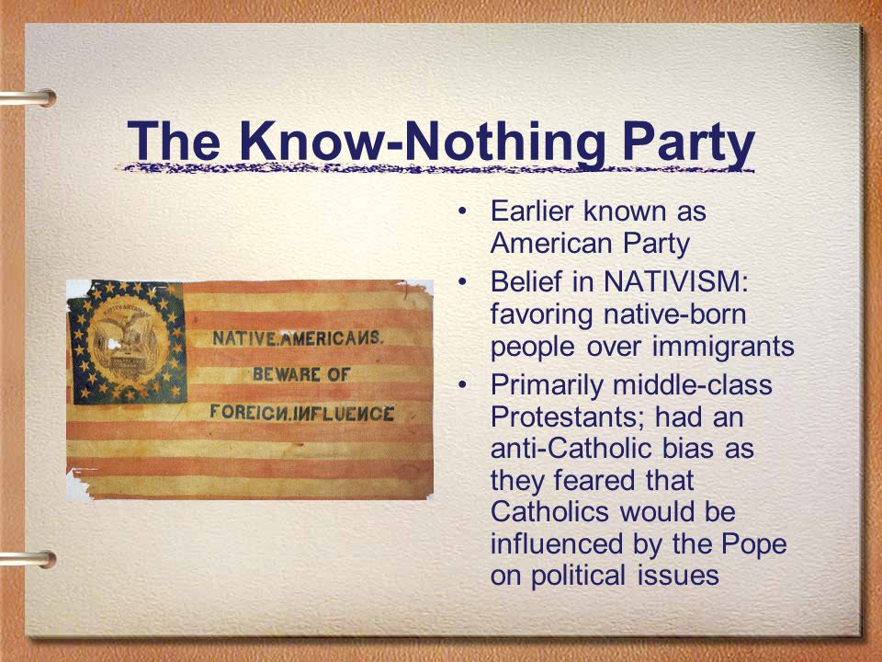
SSUSH8e: Evaluate the Kansas-Nebraska Act, the failure of popular sovereignty, Scott v. Sanford, John Brown’s Raid on Harper’s Ferry, and the Election of 1860 as the events leading to the Civil War.

Slide 29
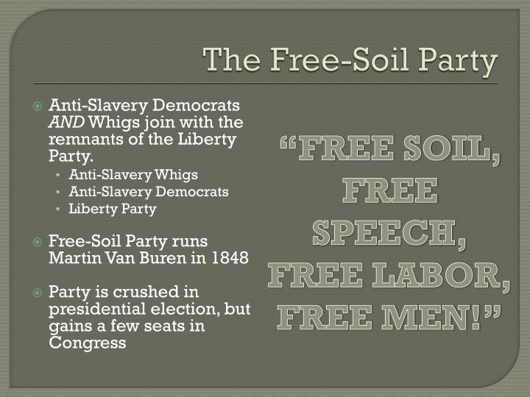
SSUSH8e: Evaluate the Kansas-Nebraska Act, the failure of popular sovereignty, Scott v. Sanford, John Brown’s Raid on Harper’s Ferry, and the Election of 1860 as the events leading to the Civil War.

Slide 30
SSUSH8e: Evaluate the Kansas-Nebraska Act, the failure of popular sovereignty, Scott v. Sanford, John Brown’s Raid on Harper’s Ferry, and the Election of 1860 as the events leading to the Civil War.
Scott v. Sanford
Scott sued for freedom because he was brought to and lived in free states with his owner.
Supreme Court decided that Scott was not eligible to sue in court because slaves are property, not citizens.
Also said that Missouri Compromise and popular sovereignty was unconstitutional, congress couldn’t disallow slavery in territories without a constitutional amendment.

Slide 31
SSUSH8e: Evaluate the Kansas-Nebraska Act, the failure of popular sovereignty, Scott v. Sanford, John Brown’s Raid on Harper’s Ferry, and the Election of 1860 as the events leading to the Civil War.
John Brown’s Raid

Slide 32
SSUSH8e: Evaluate the Kansas-Nebraska Act, the failure of popular sovereignty, Scott v. Sanford, John Brown’s Raid on Harper’s Ferry, and the Election of 1860 as the events leading to the Civil War.
Election of 1860

Slide 33
SSUSH08: Antebellum Period
Can you Guess Historical Events from a Single Picture?

Slide 34
Manifest Destiny

Slide 35
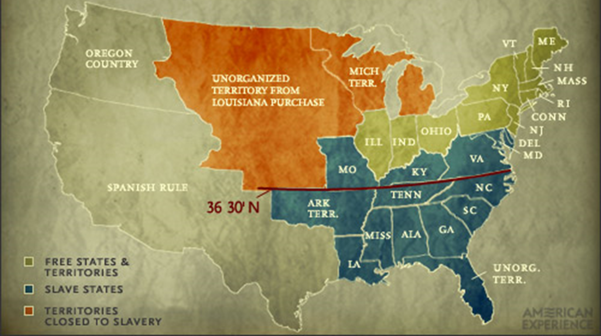
Missouri Compromise 1820

Slide 36
Oregon Treaty 1846

Slide 37
Mexican
American
War

Slide 38
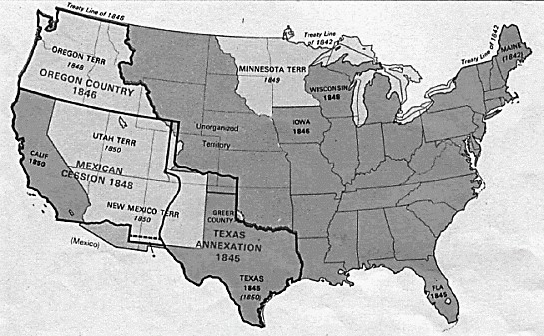
Treaty of Guadalupe-Hidalgo

Slide 39
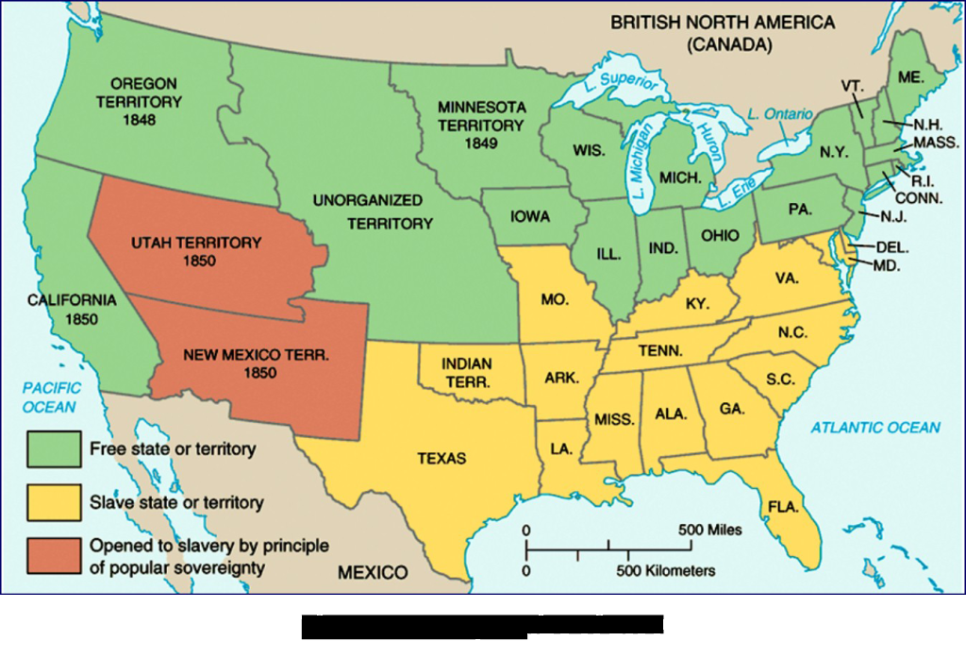
Compromiseof 1850

Slide 40
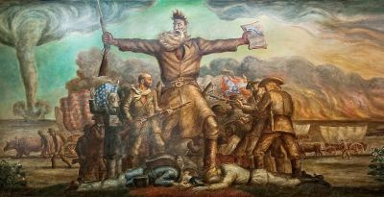
John Brown

Slide 41
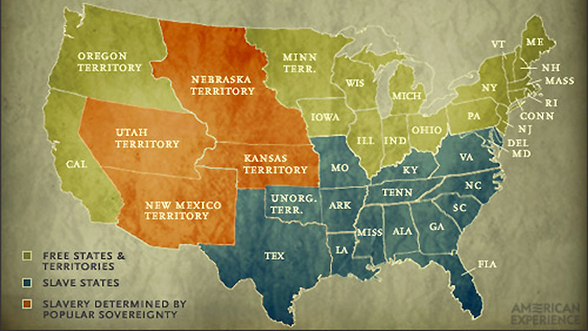
Kansas-Nebraska Act 1854

Slide 42
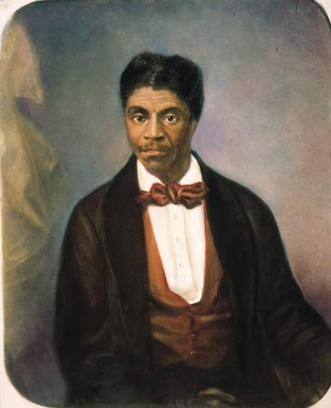
Dred Scott v Sanford

Slide 43
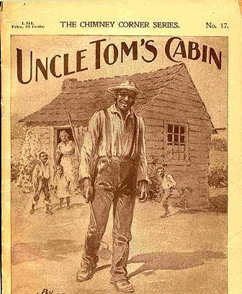
Harriett Beecher Stowe

Slide 44
Presidential Election of 1860

Slide 45
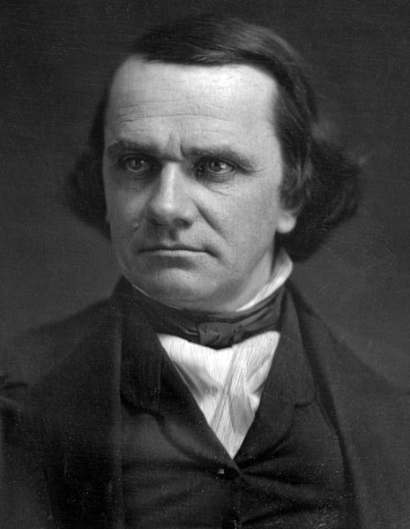
Stephen A. Douglas

Slide 46
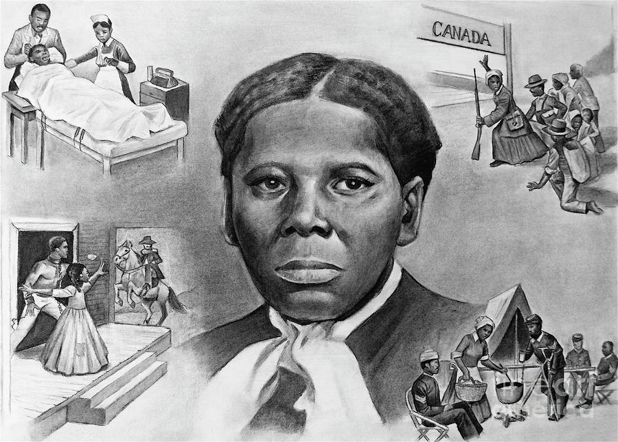
Harriett Tubman

Slide 47
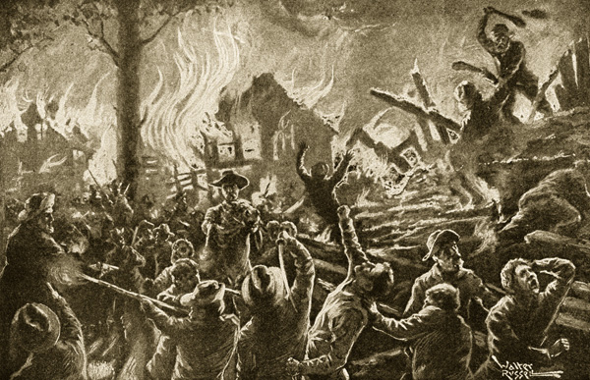
Bleeding Kansas

Slide 48
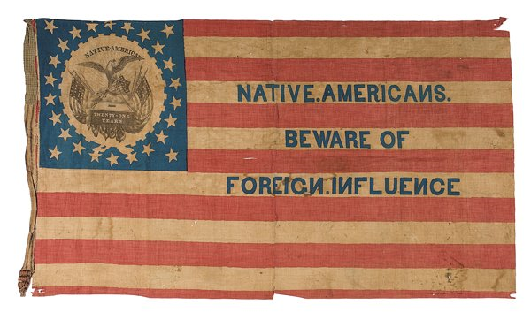
Know-Nothing Party

Slide 49
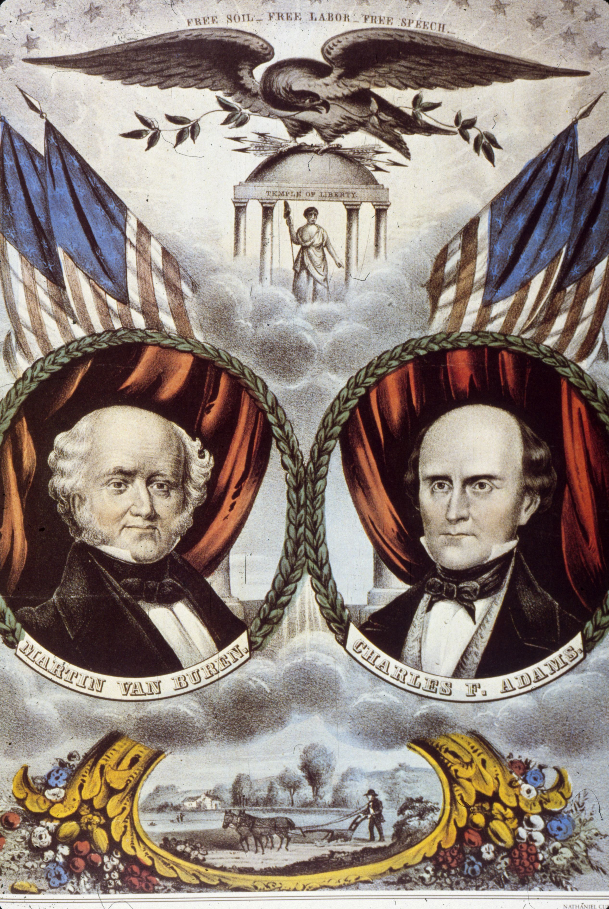
Free-Soil Party

Slide 50
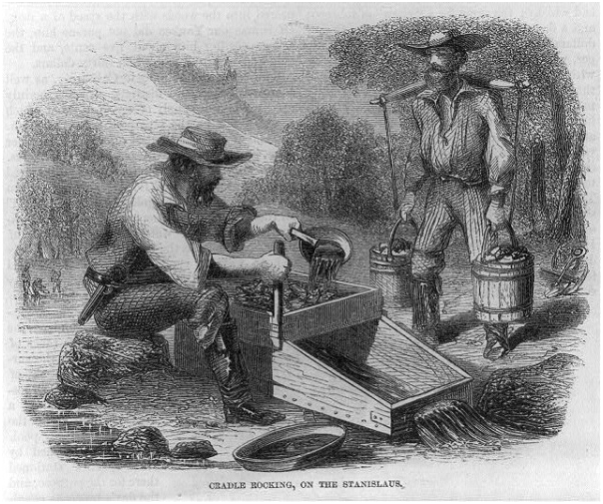
Forty-Niners

