Slide 1
World War 1
SSUSH15

Slide 2
SSUSH15 analyze the origins and impact of U.S. involvement in World War I.
Describe the movement from U.S. neutrality to engagement in World War I, including unrestricted submarine warfare and the Zimmerman Telegram.
Explain the domestic impact of World War I, as reflected by the origins of the Great Migration, the Espionage Act, and socialist Eugene Debs.
Explain Wilson’s Fourteen Points and the debate over U.S. entry into the League of Nations.

Slide 3
SSUSH15
a. Describe the movement from U.S. neutrality to engagement in World War I, including unrestricted submarine warfare and the Zimmerman Telegram.

Slide 4
Causes of WWI
Nationalism: extreme patriotism, a nation believes it is the best and should be able to rule other nations. Nationalism made European nations believe they were each the best, and a sense of competition developed.
Imperialism: Strong nations take over & exploit poorer, less powerful nations. European nations were taking over Africa and Asia.
Militarism: the process of building a strong military and producing a large supply of weapons, ammunition, and other wartime supplies.
Alliances:

Slide 5
Entangling Alliances
Central powers included:
Germany, Austria-Hungary, the Ottoman Empire, and Bulgaria.
They were called the Central Powers because they were part of Central Europe.
Allied Powers included:
Great Britain, France, Russia.
Japan and Italy joined later.

Slide 6
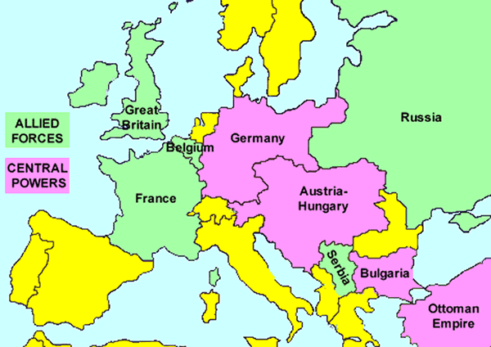

Slide 7
The spark that lit the fire
So all these countries think they are the best, and should rule all of Europe, and they are all armed to the teeth. Austrian-Hungary and Serbia specifically have a passionate dislike of each other.
On June 28, 1914, Archduke Franz Ferdinand, the heir to the Austrian throne, was shot during a parade in Sarajevo (the capital of Bosnia). The assassin was Gavrilo Princip, who was a Serbian member of the secret society The Black Hand, which wanted to get Bosnia out of Austrian control.
Austria made a list of demands to Serbia, and Serbia agreed to discuss the demands. Austria said that wasn’t good enough, and declared war on Serbia on July 28.
And the rest was due to Entangling Alliances.

Slide 8
Entangling Alliances
So on one side was Serbia
On the other side was Austrian-Hungary
Russia was allied with Serbia, which means they had an agreement to help each other
July 28, 1914, Russia began to send its military to Austria.
Germany is close to Austria, and when Russian troops appeared, Germany declared war on Russia on August 1.
Two days later, Germany also declared war on France because France and Russia were allies and they knew France would be helping Russia.
Soon, Great Britain declared war on Germany. Most of Europe involved now.

Slide 9
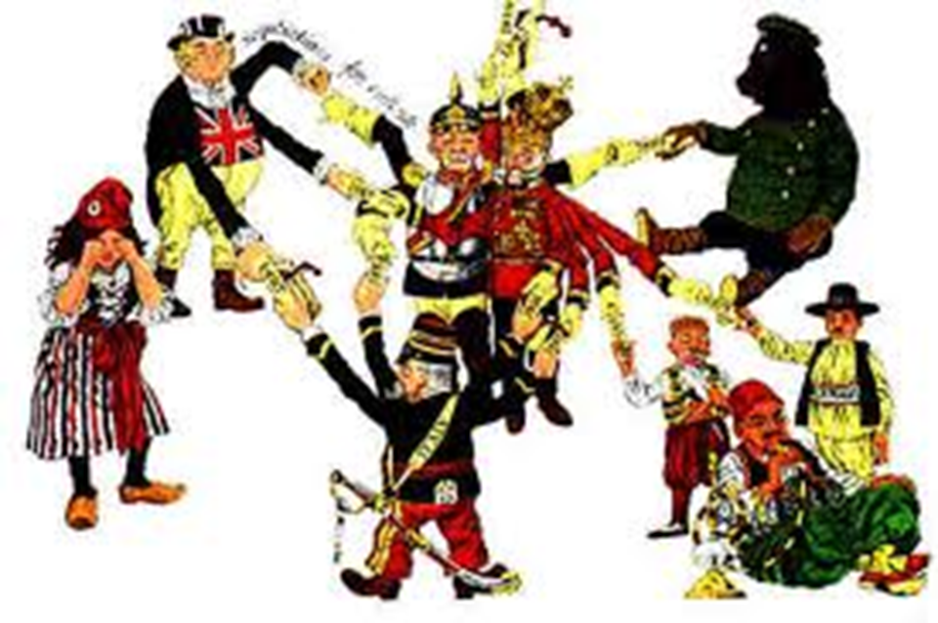

Slide 10
Isolationism
America decided to practice isolationism. This means we were neutral- we didn’t take sides.
Really, we couldn’t decide which side to support, because many Americans could still trace their heritage back to Europe.
England blockaded Germany’s coast, and kept ships with weapons and food from getting through.
So Germany begins to use unrestricted submarine warfare- sinking any ship near England using U-boats, which were submarines.

Slide 11
The Lusitania
The Lusitania was a British ship that U-boats sank in 1915. Over a thousand people died, and more than a hundred of them American.
Americans were furious.
Then, in 1917, the Zimmerman Telegram made things worse. It was a telegram from Germany to the German ambassador to Mexico, and it contained plans for a deal between Mexico and Germany- Mexico would help Germany in exchange for territory: Texas, New Mexico, and Arizona.
In April 1917, America declares War on Germany and enters WWI.

Slide 12
SSUSH15: WWI
b. Explain the domestic impact of World War I, as reflected by the origins of the Great Migration, the Espionage Act, and socialist Eugene Debs.

Slide 13
The War in America
In the US, everyone was impacted by the war.
Factories began to manufacture goods needed for war- weapons, ammunition, food, medicine.
Unions grew as factories needed workers, and the government created a board to mediate when unions and companies had issues.
The government promoted measures to save food like “Meatless Monday.” This prevented them from having to ration.

Slide 14
The Great Migration
During the WWI years, factories needed workers, but the military also needed soldiers.
Many African Americans left the south, where they had barely survived as sharecroppers, and moved north to cities in order to take factory jobs, where they were paid better and sometimes were treated better than in the south.
This shift is called the Great Migration. Before this, the African American population was centered in the south.

Slide 15
Impact of Nativism
Many Americans did not trust German-Americans.
German-Americans lost their jobs and German culture was considered by many to be unpatriotic. This was when frankfurters (named after a city in Germany) began to be called hot dogs.
In June of 1917, the Espionage and Sedition Acts became law.
These punished anybody who seemed to be taking Germany’s side or anyone that criticized America.

Slide 16
Eugene V. Debs
The Espionage and Sedition Acts also made it possible for people that support socialism to be punished.
Socialism is a type of system in which the government controls private property and regulates the economy.
Eugene Debs was a labor leader who disagreed with the draft. He was sentenced to ten years in prison.
Labor leaders were threatened because: if they pushed for better wages, and didn’t get it, they encouraged workers to strike, which would weaken the American military effort.

Slide 17
SSUSH15: WWI
c. Explain Wilson’s Fourteen Points and the debate over U.S. entry into the League of Nations.

Slide 18
Wilson’s Fourteen Points
President Wilson came up with his Fourteen Points.
There were three categories: 1-5 were to prevent another war, 6-13 were about making national boundaries in Europe match the nationalities of the people, and 14 was about creating the League of Nations.

Slide 19
The first Five Points
1. There should be no secret treaties among nations.
2. Freedom of the seas should be maintained.
3. Tariffs and other economic barriers between nations should be lowered to foster trade.
4. Arms should be reduced.
5. Colonial policies should take care of the colony populations, not just the imperial nation who owns them.

Slide 20
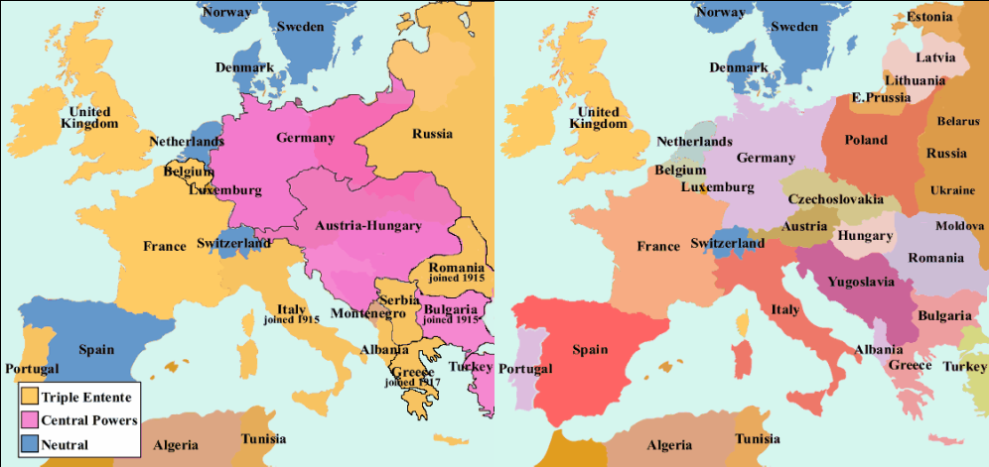

Slide 21
President Woodrow Wilson
Wilson ran for president by claiming he would keep the country out of war, but Americans wanted war.
When the war came to an end, Wilson’s fourteenth Point proposed the development of a League of Nations- kind of like a Supreme Court for nations, to prevent a war as terrible as WWI again.
But the Allies had been traumatized, and wanted Germany, who was blamed for the war, to suffer. The League of Nations was formed, but failed because Congress believed it would drag America into war and America never joined.

Slide 22
WWI
d. Describe passage of the Eighteenth Amendment, establishing Prohibition, and the Nineteenth Amendment, establishing woman suffrage.

Slide 23
The 18th Amendment
The 18th Amendment was passed in 1920 and began the time period known as Prohibition. Organizations like the Women’s Christian Temperance Union pushed for the sale of alcohol to be made illegal, and that is what the 18th Amendment did. People blamed many problems on alcohol abuse, but by the mid-1920s, not many people supported Prohibition, and most Americans ignored it and drank in speakeasies- secret saloons.
Prohibition lasted from 1920-1933.

Slide 24
Women’s Suffrage
Since the Seneca Falls Conference in 1848, more and more women wanted the right to vote.
During WWI, many women worked to support the troops by knitting socks and leading committees. Women protested and held marches and rallies and finally, in 1919, the Nineteenth Amendment passed, giving women the right to vote.

