Slide 1
REVIEW FOR THE ECONOMICS END OF COURSE TEST

Slide 2
REVIEW FOR THE ECONOMICS END OF COURSE TEST
INSTRUCTIONS:
Go through the slides and answer each question in the packet; the slide numbers are listed for each question

Slide 3
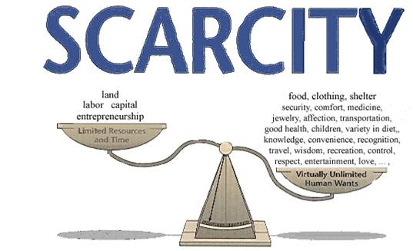
The combination of unlimited wants and limited resources combine to cause scarcity

Slide 4
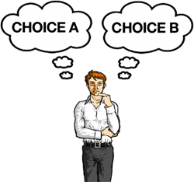
“Opportunity cost” is the next best alternative and a “tradeoff” is an alternative that must be given up when one choice is made rather than another

Slide 5
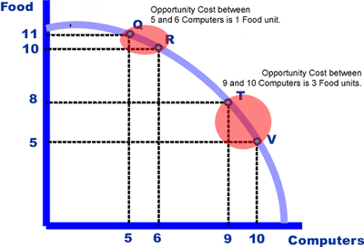
The difference is that there can be multiple tradeoffs when making a choice, but only one option can be the “next best alternative”

Slide 6
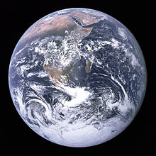
LAND: any gift of the Earth (such as trees, animals, plants, water, metals, etc.)

Slide 7
LABOR: work done by a person (for example, installing a window on a house)

Slide 8
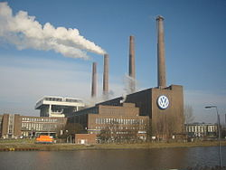
CAPITAL: any good used to make another good (for example, factories and equipment)

Slide 9
ENTREPRENEUR: a person who comes up with the idea to combine the productive resources

Slide 10
What to produce?
How to produce?
For whom to produce?

Slide 11
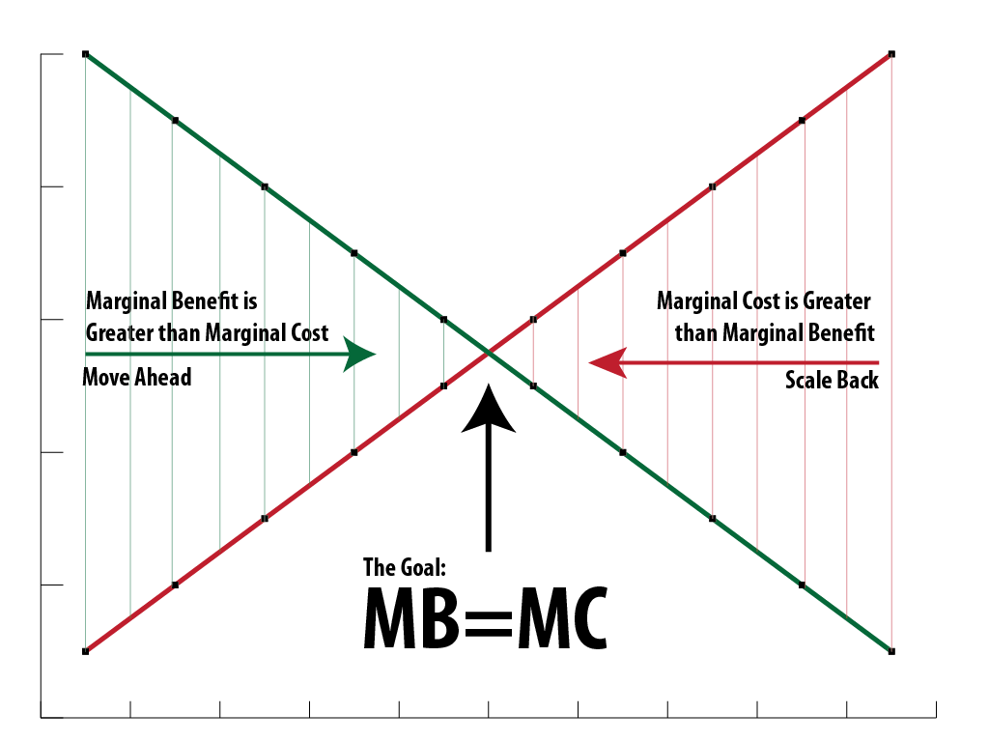
“Marginal benefits” are the extra benefits gained by taking an action
“Marginal costs” are the extra costs from taking an action

Slide 12
If the marginal benefit exceeds the marginal cost of the action, it is the rational decision to take the action
If the marginal cost exceeds the marginal benefit, the action should NOT be taken

Slide 13
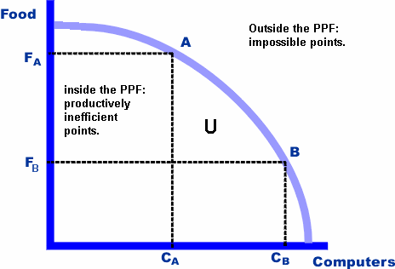
The production possibilities curve is a graphical representation of the concept of opportunity cost; it shows how much of one item must be given up in order to obtain a certain amount of the other item

Slide 14
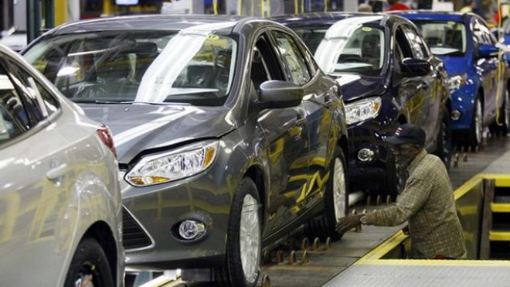
An example of “specialization in the workplace” is the person who attaches tires to the car in a car factory

Slide 15
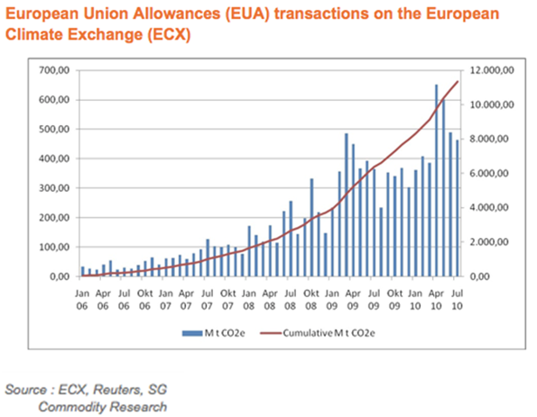
“Voluntary, non-fraudulent exchange” is trade between individuals, businesses, and/or governments that is done willingly and without any deceit

Slide 16
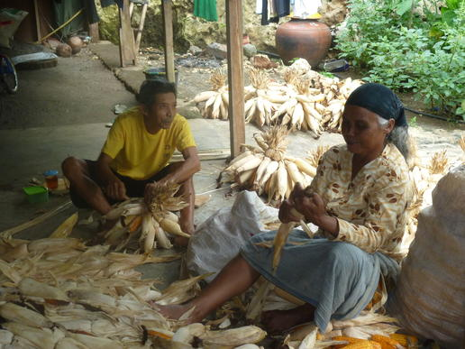
A traditional economy answers the basic economic questions through customs and past practices

Slide 17
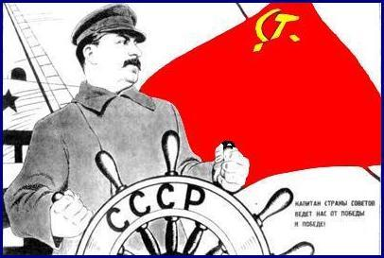
A command economy answers the basic economic questions through a central bureaucracy

Slide 18
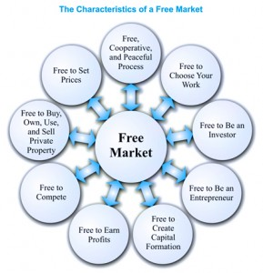
A market economy answers the basic economic questions through the coming together of buyers and sellers in the marketplace

Slide 19
A command economy has the MOST government regulation
A market economy has the LEAST government regulation

Slide 20
Economic freedom is the ability to make choices that affect your economic well-being

Slide 21
Economic security is the protection from adverse economic effects

Slide 22
Economic equity is the knowledge that everyone has a chance to achieve their economic goals

Slide 23
Economic growth is the ability to make yourself better off in life and possess more material goods

Slide 24
Economic efficiency is the wise use of economic resources

Slide 25
Economic stability is knowing that prices and employment are not going to change drastically

Slide 26
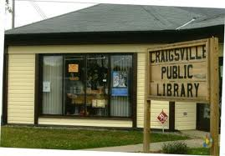
A public service or good are services or goods that are paid for and consumed collectively
The government provides them because they are generally not profitable to produce in the private sector

Slide 27
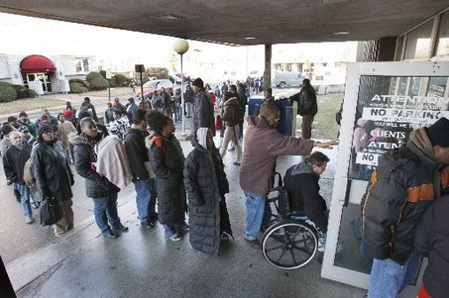
The government redistributes income through welfare and entitlement programs, such as Social Security and Medicaid

Slide 28
The government protects property rights through the enforcement of contracts in the court system

Slide 29
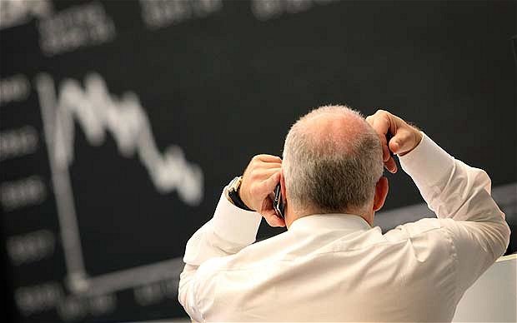
The government resolves market failures through regulations, legislation, and the providing of public goods and services

Slide 30
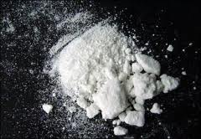
Government regulation affects consumers and producers by limiting what is produced, how it is produced, or for whom it is produced
Examples: narcotics are illegal to produce; child labor is illegal; certain products (like tobacco) cannot be sold to children

Slide 31
“Productivity” is the amount of output produced with a given amount of productive resources

Slide 32
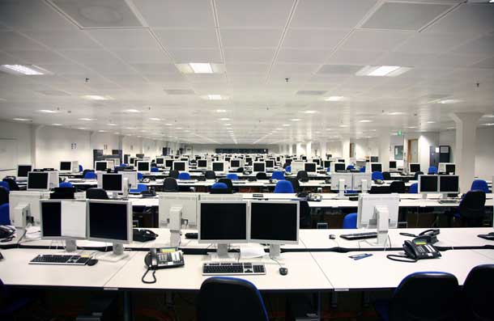
Investments, improved equipment, and technology increase economic growth; as businesses become more productive, they are able to lower marginal costs of production, leading to greater efficiency in production

Slide 33
Three examples of investment in human capital are (1) training, (2) education, and (3) healthcare
Investing in human capital leads to economic growth because as people become more productive, it lowers marginal costs of production, which leads to greater efficiency in production

Slide 34
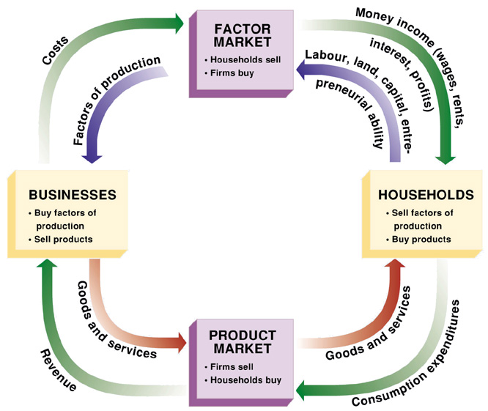
THE CIRCULAR FLOW OF THE ECONOMY

Slide 35
Money flows from the households to the product market in exchange for goods and services
Money from the product market flows to businesses that pay for productive resources in the factor market
Money from the factor market is taken to households in exchange for those productive resources
Money serves as a medium of exchange because it is accepted by all parties as payment for goods and services

Slide 36
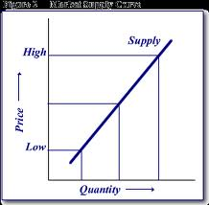
LAW OF SUPPLY: Price and quantity supplied are directly related: as price rises, so does the quantity supplied rise; as price falls, so does quantity supplied fall

Slide 37
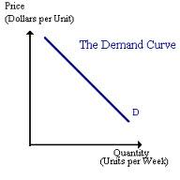
LAW OF DEMAND: Price and quantity demanded are inversely related: as price rises, quantity demanded falls; if price falls, quantity demanded rises

Slide 38
Buyers and sellers come together in the market
When price is too high, quantity demanded is lower than quantity supplied, so price tends to fall into equilibrium
If price is too low, a shortage will cause price to rise until equilibrium is reached

Slide 39
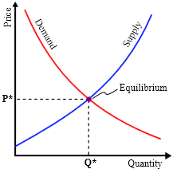
SUPPLY CURVE AND DEMAND CURVE WITH EQUILIBRIUM POINT

Slide 40
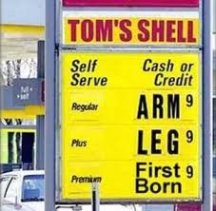
Prices serve as incentives in a market economy because prices indicate to producers what to produce and to consumers what to purchase

Slide 41
SIX DETERMINATES OF DEMAND:
Consumer income
Consumer tastes
Price of compliments
Price of substitutes
Consumer expectations
Number of consumers

Slide 42
FACTORS THAT CAN AFFECT THE SUPPLY CURVE:
Cost of resources
Productivity
Technology
Taxes
Subsidies
Expectations
Government regulations
Number of sellers

Slide 43
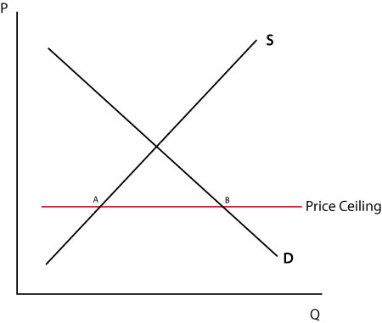
SUPPLY AND DEMAND CURVE WITH A PRICE CEILING
This will cause a shortage due to quantity demanded exceeding quantity supplied

Slide 44
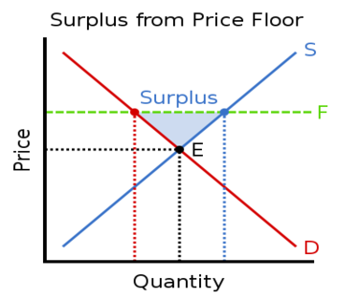
SUPPLY AND DEMAND CURVE WITH A PRICE FLOOR
This will cause a surplus due to quantity supplied exceeding quantity demanded

Slide 45
Price elasticity is the responsiveness of consumers to a change in price; it answers the question: does a change in price cause a small, large, or proportional change in quantity demanded?

Slide 46
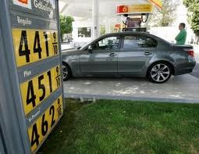
When demand is elastic, a small change in price will have a large change in quantity demanded

Slide 47
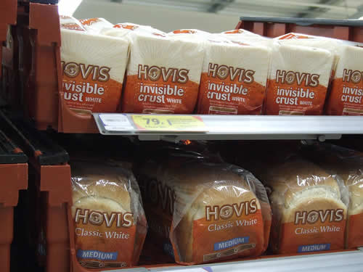
When demand is inelastic, a small change in the price will have the effect of a small change in the quantity demanded

Slide 48
ADVANTAGE and DISADVANTAGE:
Sole Proprietorship
ADVANTAGE: there is easy entry into the market; you are in business for yourself
DISADVANTAGE: unlimited liability; limited lifespan for the company; more difficult to rise capital

Slide 49
ADVANTAGE and DISADVANTAGE:
Partnership
ADVANTAGE: easier to raise capital; each partner can bring their areas of expertise into the business
DISADVANTAGE: unlimited liability; limited life for the company; possible conflicts between partners

Slide 50
ADVANTAGE and DISADVANTAGE: Corporation
ADVANTAGE: least difficult to raise capital; unlimited life for the company; limited liability
DISADVANTAGE: double taxation of the both the corporation (which is considered a legal entity) and the people in it

Slide 51
The chief purpose of business is to maximize profit

Slide 52
FIVE CHARACTERISTICS OF PURE COMPETITION
Identical goods
Large numbers of buyers and sellers
Buyers and sellers act independently
Well-informed buyers and sellers
Buyers and sellers are free to enter the market, conduct business, and leave the market

Slide 53
In a MONOPOLISTIC competition, the one characteristic of a pure competition that is missing is identical goods; monopolistic competition has a differentiated product, although it may seem to be the same thing. An example: pizza places or restaurants. Even if they are all Italian restaurants, they still have their own chefs, recipes, etc.

Slide 54
An oligopoly is a market structure with few large sellers (example: cell phone companies)

Slide 55
A monopoly is a market structure with only one seller (example: Microsoft was accused of trying to have a monopoly over the computer industry)

Slide 56
The equation for G.D.P. is
GDP = C + I + G + (X – M)
C = consumer sector
I = investment sector (businesses)
G = government sector
(X – M) = exports minus imports; you may also substitute in Nx (net exports), N (net exports), or F (foreign sector)

Slide 57
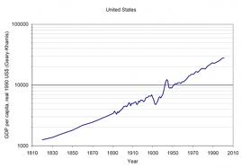
Gross Domestic Product is the total of all goods and services produced within a country’s borders within a given time period

Slide 58
Economic growth is defined as an increase in a nation’s total output of goods and services over time

Slide 59
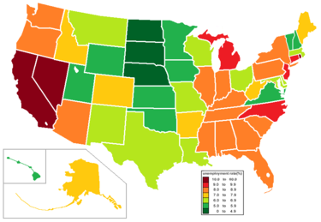
Unemployment can be defined as the state of working less than one paid hour per week while looking for paid employment

Slide 60
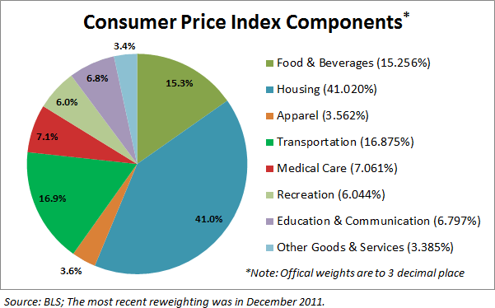
The Consumer Price Index (CPI) is used to measure price changes for a market basket of frequently used consumer items

Slide 61
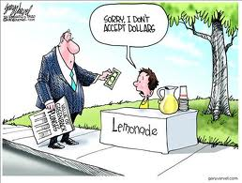
Inflation is a general increase in price levels

Slide 62
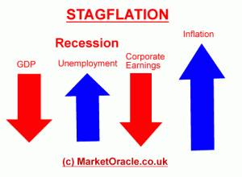
Stagflation is inflation coupled with a lack of economic growth

Slide 63
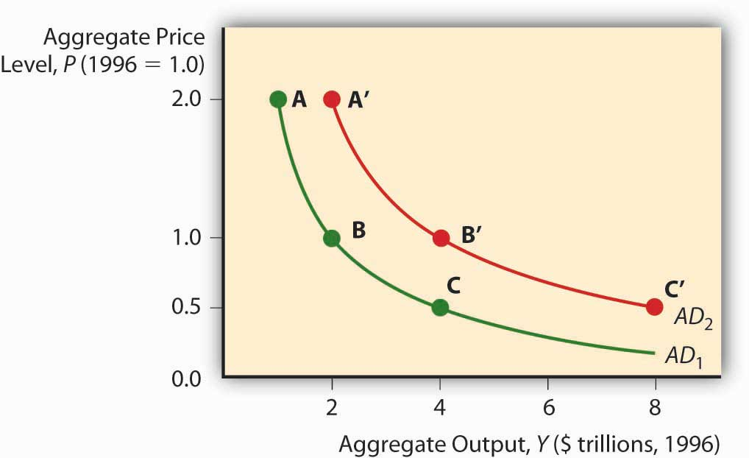
“Aggregate supply” is the total value of all goods and services all firms would produce in a specific period of time at various price levels

Slide 64
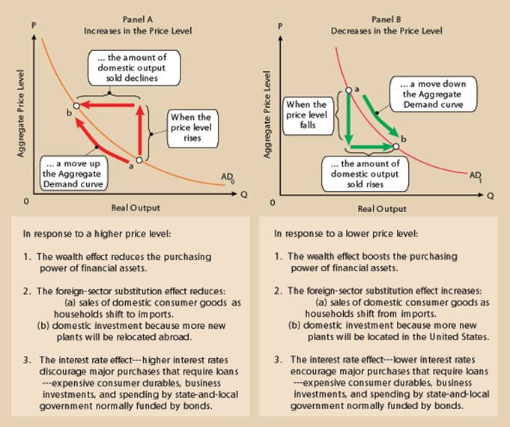
“Aggregate demand” is the total value of all goods and services demanded at different price levels

Slide 65
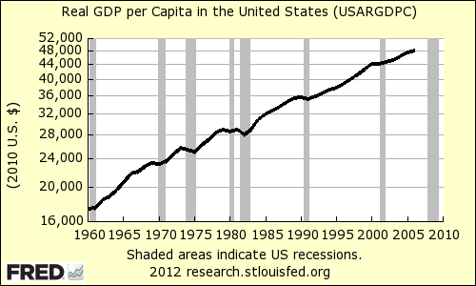
Economic growth is calculated through increases in real GDP over time

Slide 66
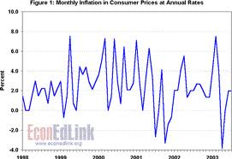
Inflation is calculated by dividing the CPI for the current year by the CPI for the base year

Slide 67
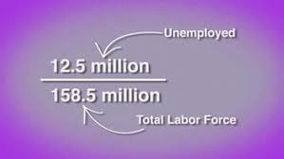
Unemployment is calculated dividing the total number of unemployed people by the total number of people in the civilian labor force

Slide 68
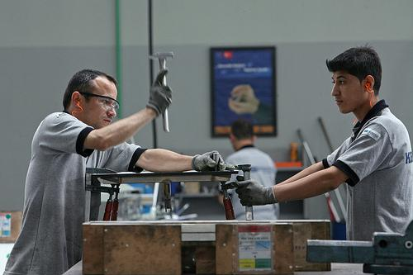
“Structural” unemployment is unemployment that is caused by fundamental changes in the economy

Slide 69
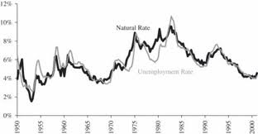
“Cyclical” unemployment is unemployment that is caused by regular ups and downs in the business cycle

Slide 70
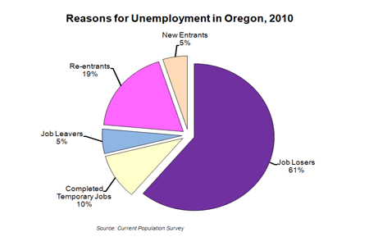
“Frictional” unemployment is the state of being in between jobs either by choice or other factors not related to the economy

Slide 71
FOUR STAGES OF THE BUSINESS CYCLE
Peak (2) Contraction (or recession)
(3) Trough
(4) Expansion

Slide 72
A “recession” is two consecutive quarters of negative GDP growth

Slide 73
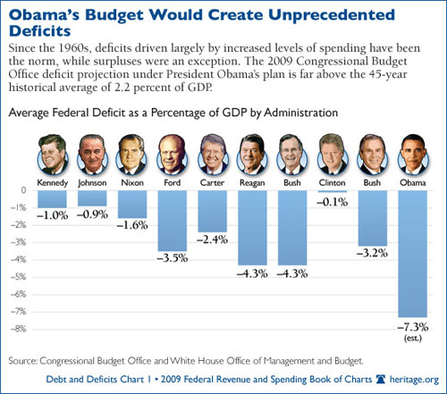
A “deficit” is when more money is spent in a single budget than is received in revenue

Slide 74
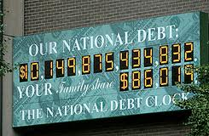
A deficit is different from the national debt in that the national debt is the total amount borrowed over time

Slide 75
The Federal Reserve System is a decentralized organization of twelve districts that are overseen by a central Board of Governors located in Washington DC. The Board of Governors are appointed by the President to a single 14-year term (terms are staggered) and are approved by the Senate

Slide 76
“Monetary policy” are the actions by the Federal Reserve increasing and decreasing of the money supply to affect the cost and availability of credit

Slide 77
The three major tools of monetary policy that the Federal Reserve uses are (1) Reserve Requirement (2) Discount Rate (3) Open Market Operations

Slide 78
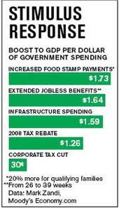
“Fiscal policy” are the actions by the legislative and executive branches of government in tax and spending decisions

Slide 79
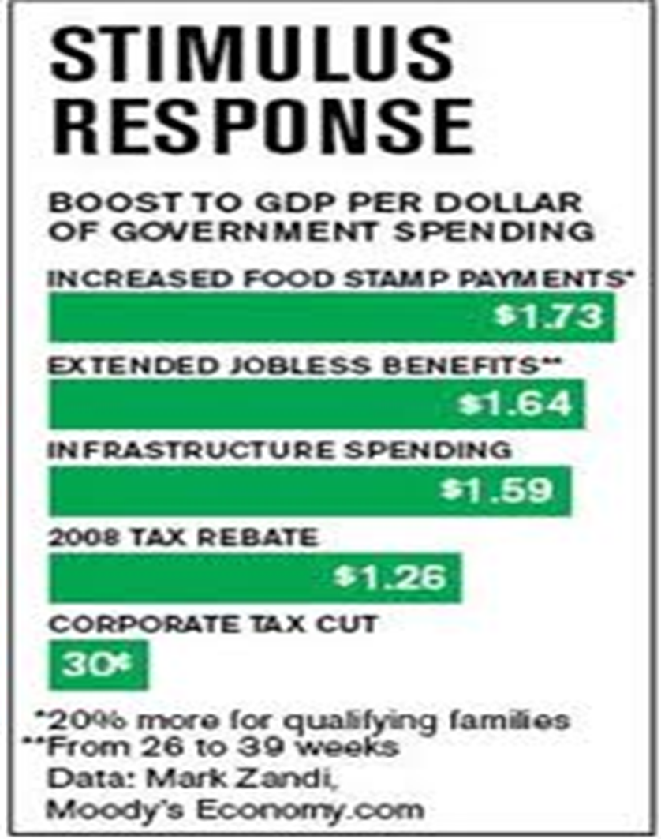
The legislative and executive branches use fiscal policy to regulate the economy through tax and spending decisions designed to purchase goods and services or give people or businesses incentives to do so

Slide 80
“Comparative advantage” is the ability to produce a good or service at a lower opportunity cost

Slide 81
“Absolute advantage” is the ability to produce more of a good or service

Slide 82
Balance of trade is the difference between the amounts of goods exported to a country and the amount of goods imported from that country (X – M). Balance of record shows the payments and receipts of the residents of the country in their transactions with residents of other countries

Slide 83
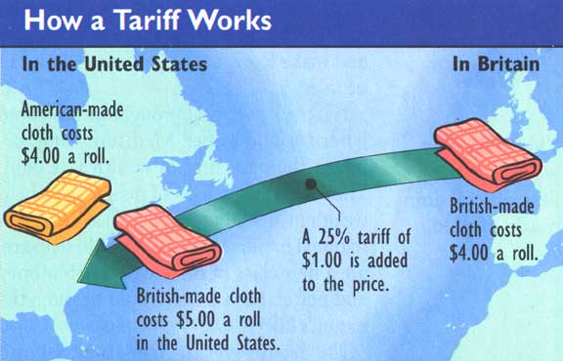
A “tariff” is a tax on an import

Slide 84
A “quota” is a limit of the number of goods that may be imported from a specific country
An “embargo” is the restriction of exports to a specific country
The government uses standards as a trade barrier by regulating the quality of goods that are imported from a country (for example, toys may not be made using lead-based paints)

Slide 85
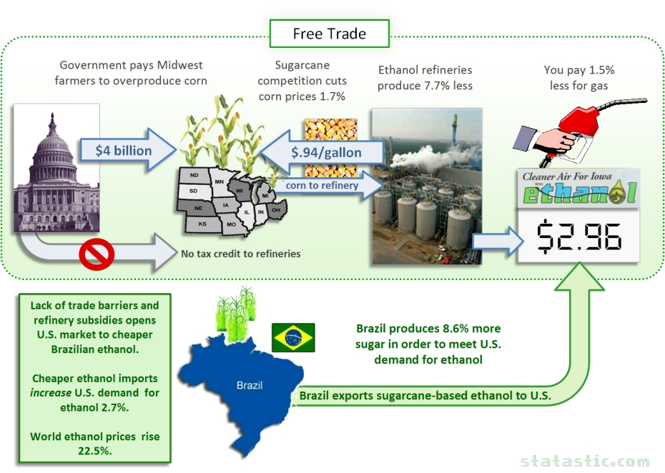
The government uses subsidies as a trade barrier by making domestic goods cheaper for consumers to buy, so that customers are less likely to turn to an imported substitute (for example, American cotton may be subsidized, leading to a decrease in demand for the now more expensive Egyptian cotton)

Slide 86
The costs of trade barriers are less choice and more expensive goods. The benefits of trade barriers are the protection of domestic industries, national pride, and national security

Slide 87
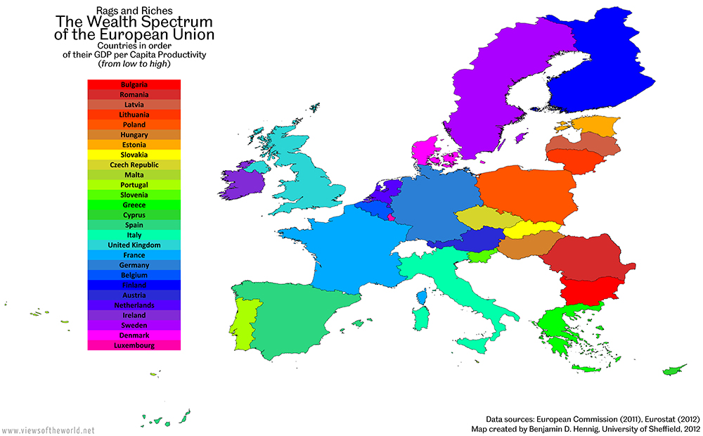
The EU (European Union) is based in Europe

Slide 88
NAFTA (the North American Free Trade Agreement) is based in North America

Slide 89
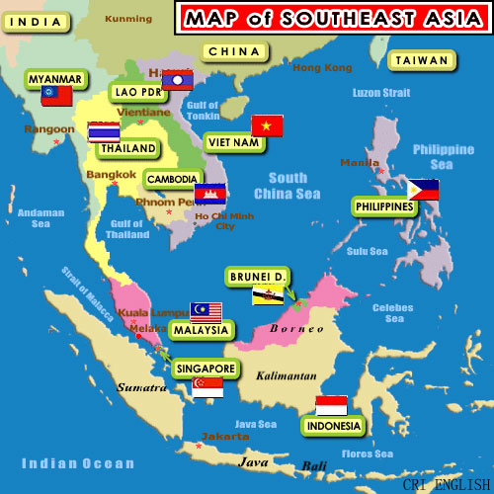
ASEAN (Association of Southeast Asian Nations) is based in Asia

Slide 90
An argument IN FAVOR of free trade is that there are lower cost of goods and more choice
Arguments AGAINST free trade are national pride, protecting domestic industries, protecting domestic jobs, and national security

Slide 91
Supply and demand determine the exchange rates between national currencies by coming to an equilibrium price; as more goods are demanded from a foreign country, there will be an increase in demand for that country’s currency, leading to an appreciation of value of the foreign currency and vice versa

Slide 92
The appreciation of the U.S. Dollar in terms of the British Pound Sterling affects trade between the United States and Great Britain in that it becomes less expensive to import goods from Britain but more expensive for the British to buy American goods

Slide 93
Commercial Banks are for-profit corporations; they will generally charge higher interest rates on loans and provide lower interest rates on accounts
Credit Unions are owned by the account holders (members); since the members are the owners, there is an incentive to have lower interest rates on loans but pay higher interest on accounts at the Credit Union

Slide 94
As risk increases, the potential rewards (higher payments) also increases

Slide 95
During inflation, debtors benefit from paying back loans using inflated (less valuable) dollars
During inflation, creditors lose from receiving payments in inflated (less valuable) dollars. Savers also lose if inflation rates exceed interest rates. People on fixed incomes lose by being able to purchase less for the same amount of money

Slide 96
“Progressive tax”: as income rises, so does the percent of income paid to the tax (example: income tax)
“Proportional tax”: everyone pays the same percent of income to the tax (example: Medicare tax)
“Regressive tax”” as income rises, the percent of income paid to the tax decreases (example: sales tax on food)

Slide 97
Increasing sales tax generally affects the poor more than the rich because they have to pay a greater portion of their income to the tax
For example: if a person earning $100,000 per year were to buy a loaf of bread for $1.00, sales tax would be 2 cents. And if a person earning $20,000 per year were to buy that same loaf of bread, the sales tax is still 2 cents. That is a greater portion of his income as compared to the wealthier person.

Slide 98
THE FOUR “Cs” OF CREDIT
Collateral: what can the creditor take away if the loan is defaulted on?
Capital: how much money do you have available?
Character: do you have a history of repaying your debts?
Capacity: do you have the capacity to pay back the debt?

Slide 99
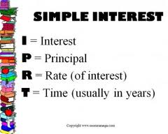
Simple interest: interest earned on just the principal

Slide 100
Compound interest: interest earned on both the principal and interest already earned

Slide 101
Insurance deductibles are the amounts you pay out of pocket when you make a claim
For example: there is $3000 in damage to your car and you have a $500 deductible; the insurance company pays $2500 and you pay $500

Slide 102
Insurance premiums are the amount of money you pay to purchase insurance

Slide 103
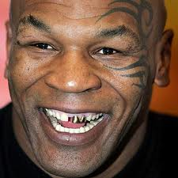
IF YOU HAVE CORRECTLY ANSWERED ALL OF THE QUESTIONS ON YOUR REVIEW PACKET, YOU WILL BE READY FOR THE ECONOMICS E.O.C.T.

