Slide 1
EOC Review
Reconstruction - 2001

Slide 2
Reconstruction Venn Diagram
Presidential Reconstruction
(Lincoln & Johnson)
Congressional Reconstruction
(Radical Republicans)
10% Plan
Pardoned Confederates
No guarantee of political or
social equality
Divided into 5 military districts
Union Generals in charge
Required to ratify 14th amendment (citizenship)
13th amendment
New state constitutions

Slide 3
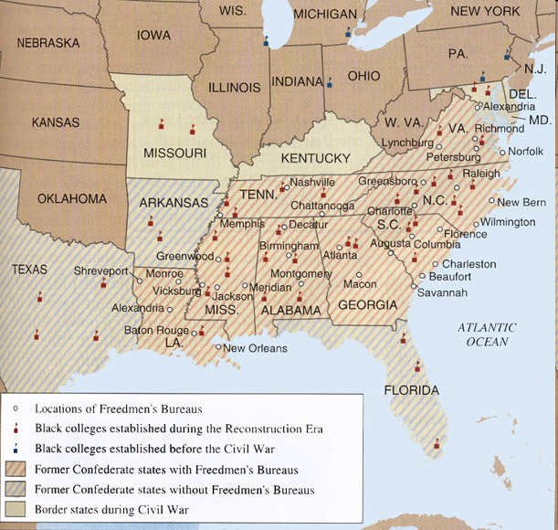
Freedmen’s Bureau
Radical Republican plan supported by Lincoln
Created by Congress in 1865
Goals:
  Provided necessities & education for black & white refugees in the South
  helped reunite families separated by slavery & war
  negotiated fair labor contracts between former slaves & white landowners

Slide 4
Reconstruction Amendments
(1865) Thirteenth - FREE
(1868) Fourteenth - CITIZENS
(1870) Fifteenth - VOTE

Slide 5
Black Codes
Black Code Examples
Generally, black people could not gather after sunset.
Freedmen convicted of vagrancy (not having a job) could be fined, whipped, or sold for a year’s labor.
Freedmen had to sign agreements in January for a year of work. Those who quit in the middle of a contract often lost all that wages they had earned.
Mothers who wanted to stay home and care for their families were forced instead to do farm labor.
- Freed people could rent land or homes only in rural areas.
issued by all southern states
laws that tried to limit rights of African Americans & keep them as landless workers
African Americans could only work in a limited number of occupations: servants or farm laborers

Slide 6
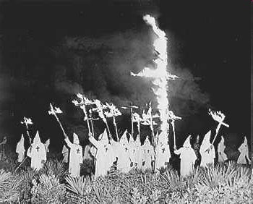
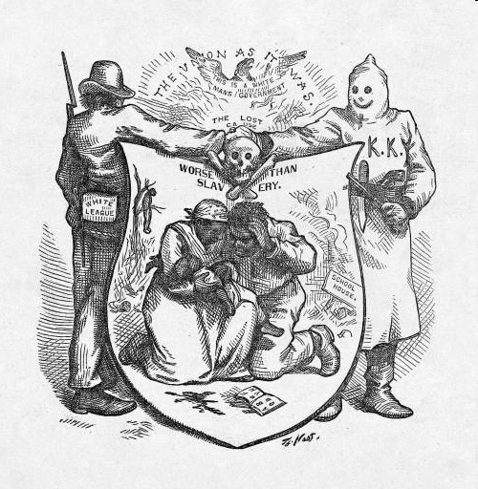
Ku Klux Klan
Formed in Tennessee in 1866
Burned homes, schools, and churches, and beat, maimed, or killed African Americans and their white allies
Dressed in white robes and hoods
Goals: scare freed people from voting

Slide 7
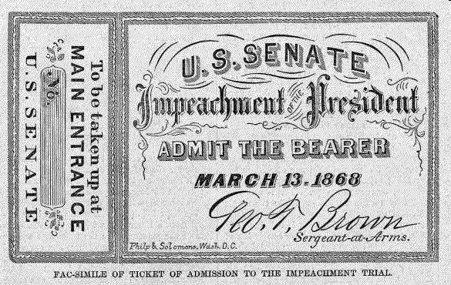
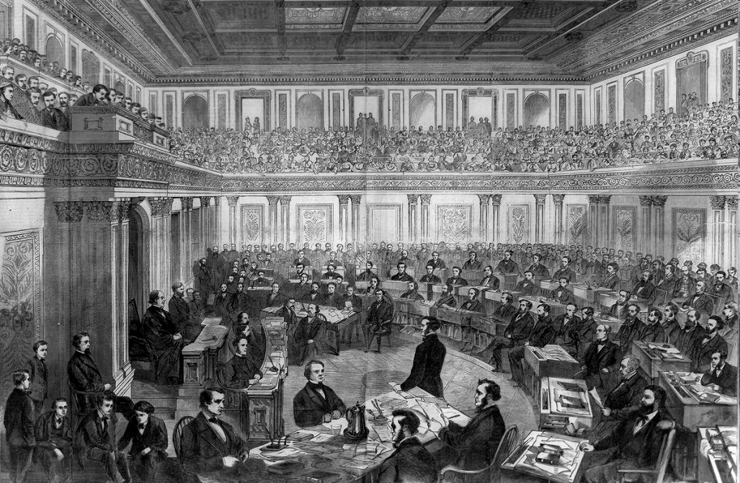
Johnson’s Impeachment
To limit the Pres.’s power, Congress passed Tenure of Office Act – Pres. needed Senate approval to remove certain officials from office
Johnson tried to fire Sec. of War Edwin Stanton (Radical Republican)
House of Reps voted to impeach Johnson (charge him with wrongdoing in office)
Trial in Senate – failed and Johnson stayed President by only one vote

Slide 8
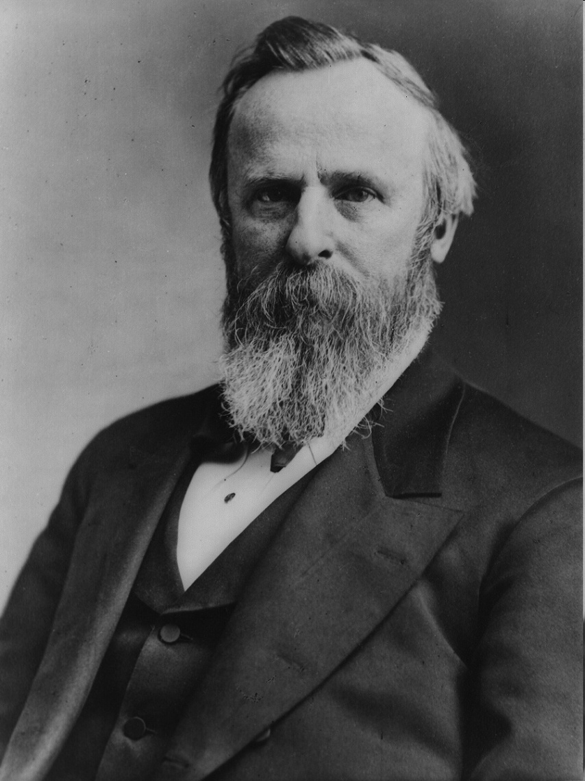
Compromise of 1877
1876 election:
  Republican Rutherford B. Hayes
  Democrat Samuel Tilden
  Tilden won popular vote & Southern states; in recount Hayes won by 1 electoral vote
Compromise of 1877
  Hayes elected President
  In return, the remaining troops were removed from South = End of Reconstruction

Slide 9
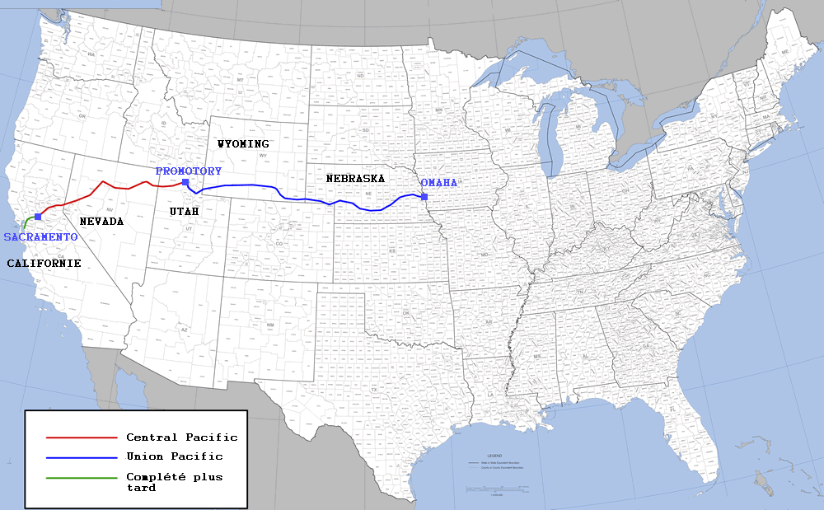
Expansion of Railroads
1st transcontinental RR completed in 1869
  Union Pacific – built from E to W (used many Irish laborers)
  Central Pacific – built from W to E (used many Chinese laborers)
  Met at Promontory Pt, Utah in 1869

Slide 10
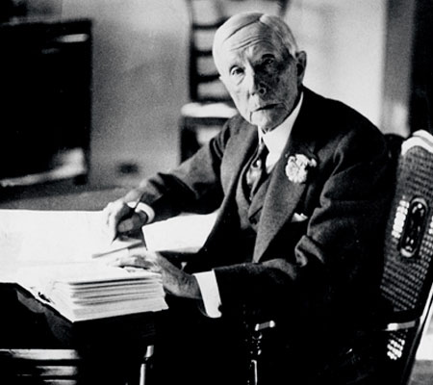
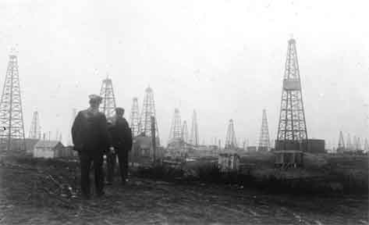
Rockefeller & Standard Oil:
Rise of Trusts & Monopolies
John D. Rockefeller Standard Oil Company tycoon
corporations wanted to increase profits:
  tried to gain a monopoly – complete control over a product or service
  created trusts – group of separate companies that are put under the management of a single group (forms a monopoly)

Slide 11
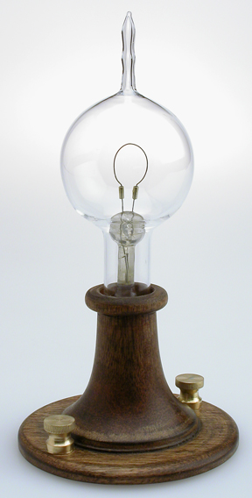
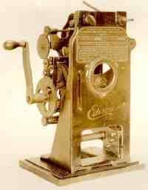
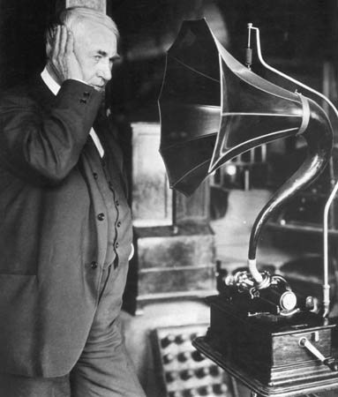
Edison’s New
Inventions
Thomas Edison’s Inventions:
  Electric light bulb (1880)
  Motion pictures (1888) - built the machine needed for filming and projecting motion pictures
  Phonograph (1877) – early record player

Slide 12
Who came to America?
“Old” Immigrants
before Civil War (1820-60)
from Northern & Western Europe
mostly skilled workers
most moved onto small towns & farms of North and West
language, customs, religion similar to Americans
faced hostility, but more easily assimilated into American society
“New” Immigrants
after Civil War (1880-1914)
from Eastern & Southern Europe & Asia
mostly unskilled workers
most remained in cities of Northeast – “ethnic islands”
language, customs, religion, appearance different to Americans
faced hostility and suspicion; not easily assimilated

Slide 13
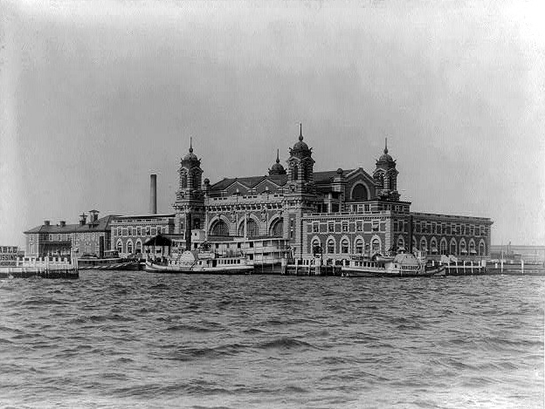
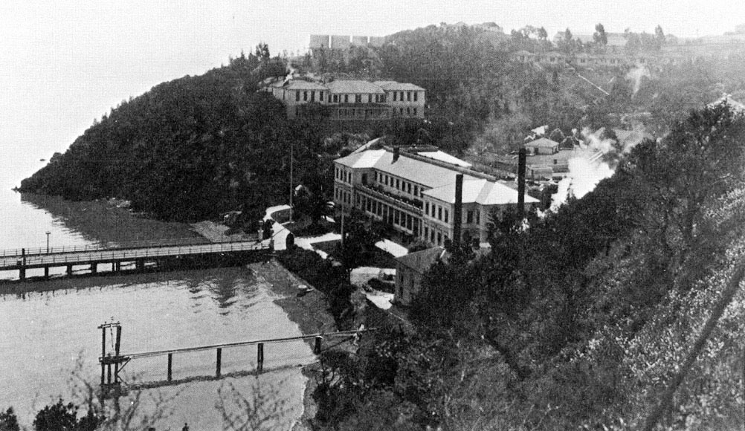
What were the major points of entry for immigrants coming to the United States?
1892 Ellis Island opened in New York Harbor as major immigration station on East coast
1910 Angel Island opened in San Francisco & became a major station on West coast
Ellis Island
Angel Island

Slide 14
The Rise of Organized Labor
Labor Union Membership Who joined? | Founder/Leaders/ Objectives/Demands | Significant activities/success/ failures
American Federation of Labor (1886) Members: only skilled workers; did NOT accept women and blacks | Founder: Samuel Gompers Objectives: improve wages, hours and working conditions; workplaces only hire union members | Success: 1890-1915 wages rose & average work-week declined has survived to present day – merged with CIO in 1955

Slide 15
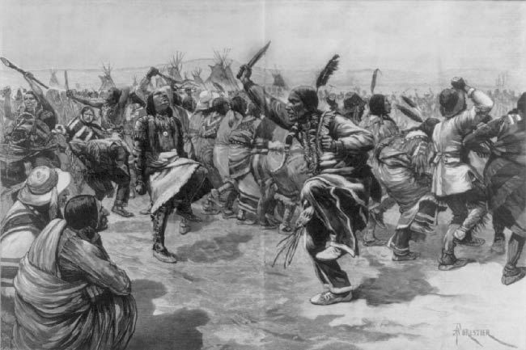
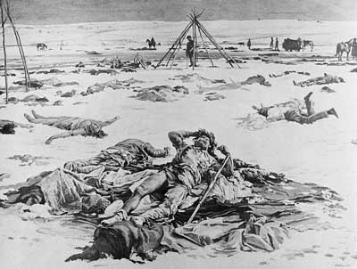
Native American Conflicts:
Wounded Knee
Wounded Knee (1890)
  U.S. government concerned, ordered arrest of Sitting Bull – he & others were killed when followers tried to rescue him
  U.S. troops followed Sioux who escaped – killed more than 100 at Wounded Knee, South Dakota
  end of Plains Indian resistance

Slide 16
Industrial Unrest: Pullman Strike
1894 Pullman Strike
  Pullman Palace Car Company laid off workers and reduced wages, later shut down plant
  Owner: George Pullman
  A.R.U. called for a nationwide strike
  Halted railroad traffic & mail delivery
  President Grover Cleveland sent federal troops to end strike
  Debs put in prison (he violated Sherman Antitrust Act)

Slide 17
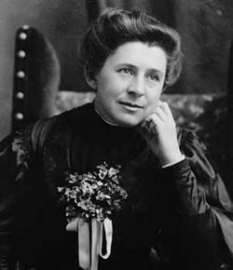
Who were the muckrakers?
journalists and writers
investigated & alerted public to wrongdoing in politics & business, raised social issues
Examples:
Ida Tarbell – A History of the Standard Oil Trust (monopolies & trusts)
Jacob Riis
Ida Tarbell

Slide 18
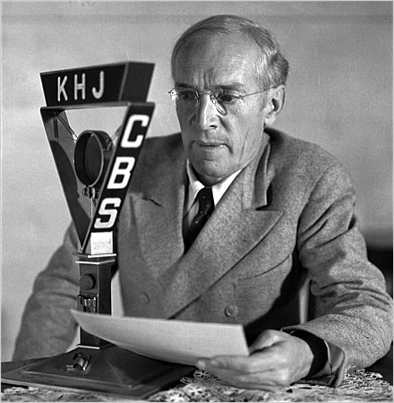
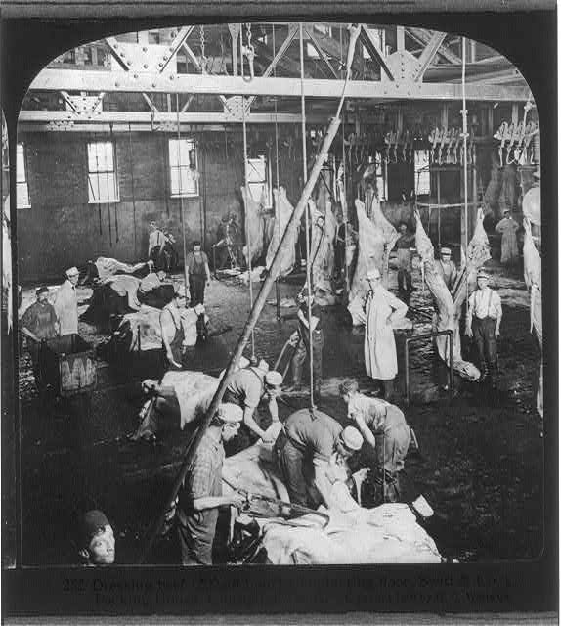
Upton Sinclair’s The Jungle
published 1906
exposed dangerous and unsanitary conditions in Chicago’s stockyards
President Roosevelt read it & got Congress to pass the Meat Inspection Act – provided federal agents to inspect meat sold across state lines & required federal inspection of meat-processing plants

Slide 19
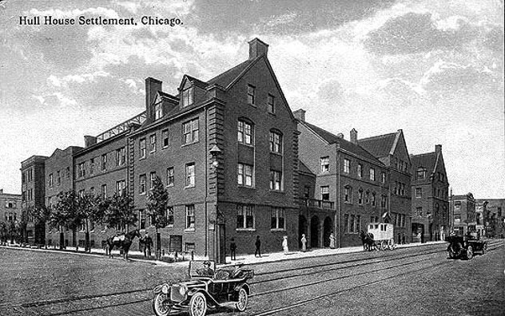
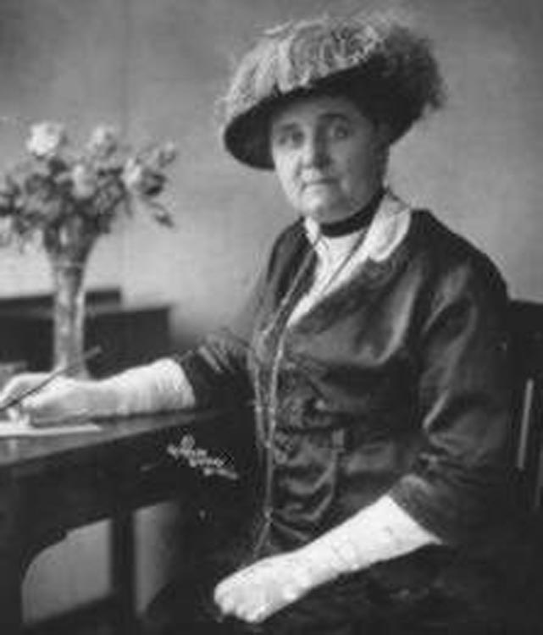
Jane Addams & settlement houses:
opened Hull House, a settlement house in Chicago
settlement houses – community centers organized to provide social services to the urban poor
examples of services provided: gave mothers child care classes, taught English, ran nursery schools and kindergartens, etc.

Slide 20
Jim Crow Laws
Segregation laws enacted in the South after Reconstruction
Plessy v. Ferguson (1896) – upheld the constitutionality of Jim Crow laws; “separate but equal” did not violate Fourteenth Amendment

Slide 21
NAACP
National Association for the Advancement of Colored People formed in 1909
interracial organization founded to abolish segregation & discrimination and to achieve political & civil rights for African Americans
strategy: use courts to challenge unfair laws

Slide 22
Progressive Political Reforms
Initiative – citizens put a proposed new law directly on the ballot
Recall – voters can remove elected officials form office before their terms end
Referendum – process that allows citizens to approve or reject a law passed by a legislature
17th Amendment – direct election of Senators by voters, not state legislatures

Slide 23
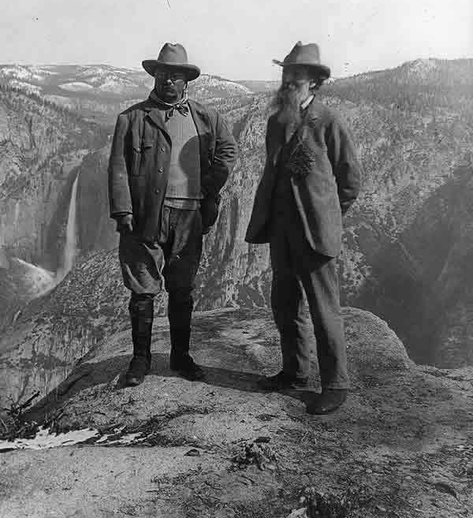
Roosevelt & the Conservation Movement
Congress created U.S. Forest Service
Set aside 200 mill. acres of land for nat’l forests & water projects
National Reclamation Act passed (1902): set aside $ from sale of public lands to fund construction of irrigation systems in states
President Roosevelt and conservationist John Muir at California’s Yosemite National Park in 1903.

Slide 24
Chinese Exclusion Act
1882 Chinese Exclusion Act –
  1st immigration restriction in U.S. history
  prohibited immigration by Chinese laborers
  limited civil rights of Chinese immigrants in U.S.
  forbade the naturalization of Chinese residents

Slide 25
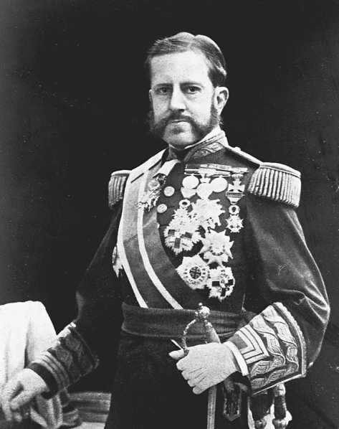
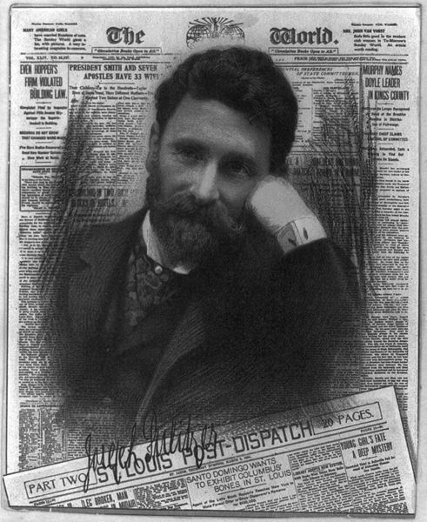
Causes of the Spanish-American War
People of Cuba & Philippines wanted to rebel against Spain
Depression of 1890 in Cuba; 1895 Cubans revolted against Spain
Spanish used harsh tactics against Cubans (Gen. Valeriano “the Butcher” Weyler)
American press (“yellow journalism”) reported cruelties; Pulitzer & Hearst created sympathy for Cubans
American investments & property destroyed during Cuban revolt
“The Butcher” Weyler
Joseph Pulitzer, journalist for New York World

Slide 26
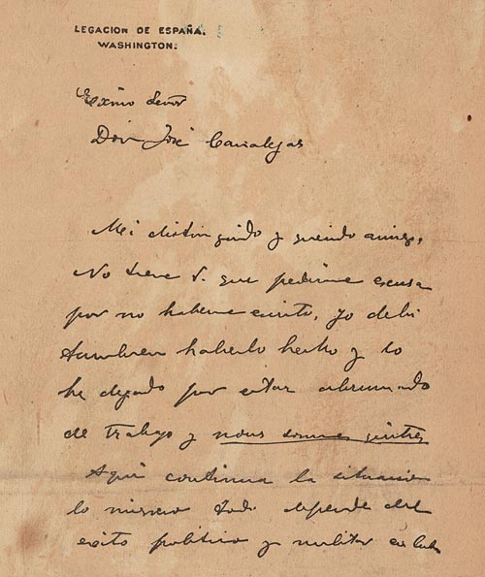
Causes lead to Spanish-American War
Feb 9, 1898 – DeLome Letter printed in Hearst’s Journal – called McKinley weak & stupid
Feb 15, 1898 – USS Maine exploded in Havana harbor killing 266 American sailors; press blamed Spain - “War? Sure!”
McKinley asked Congress to declare war
April 19, Congress declared war & adopted Teller Amendment – US had no intention of annexing Cuba

Slide 27
Effects of the Spanish-American War: Philippine-American War
U.S. annexation of Philippines led to Philippine-American War
led by Emilio Aguinaldo
3 years; 216,000 Filipinos died & 5,000 Americans
1946 - Philippines given independence

Slide 28
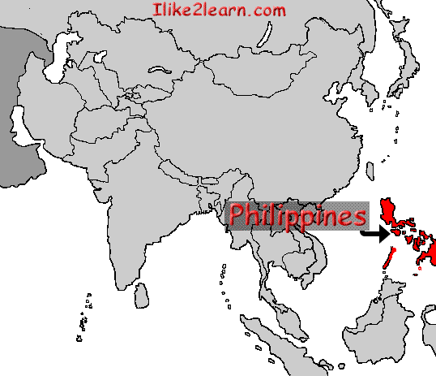
Debate over Expansion
Imperialists supported expansion
Arguments:
Americans needed new frontier
New markets for American manufactured goods
New sources of raw materials
Increase in military power
Spread American ideals: Christianity, democracy, capitalism
American superiority – our “duty”

Slide 29
Debate Over Expansion
Anti-imperialists opposed expansion
Arguments:
Rejected nation’s foundation of “liberty for all”
Faced enough difficulties at home
Threatened democratic foundations (fear of large standing armies)
Racism – might have to absorb people of different races
Expansion would cost too much
Fear of competition in job market; lower wages

Slide 30
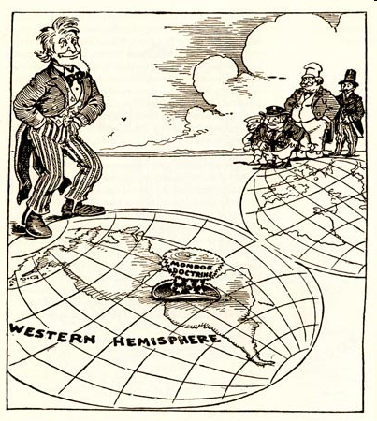
Review: What is the Monroe Doctrine?
Issued by President Monroe in 1823
We (United States) won’t bother you (Europe), you don’t bother us (Western Hemisphere)

Slide 31
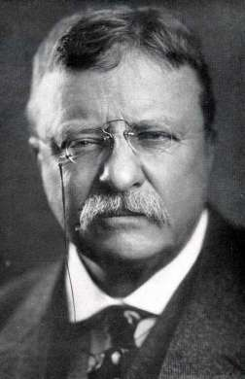
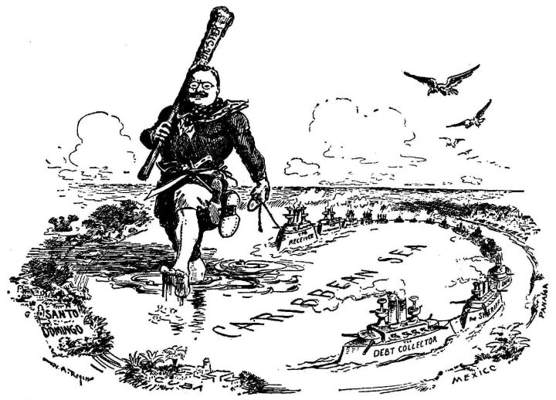
Roosevelt Corollary
(To Monroe Doctrine)
Why? Europeans threatened intervention in W. Hemisphere (to collect debts, etc.)
When and how stated? In Dec. 1904 by Roosevelt in message to Congress
Central Message: if intervention in W. Hemisphere necessary, U.S. would intervene, not European nations

Slide 32
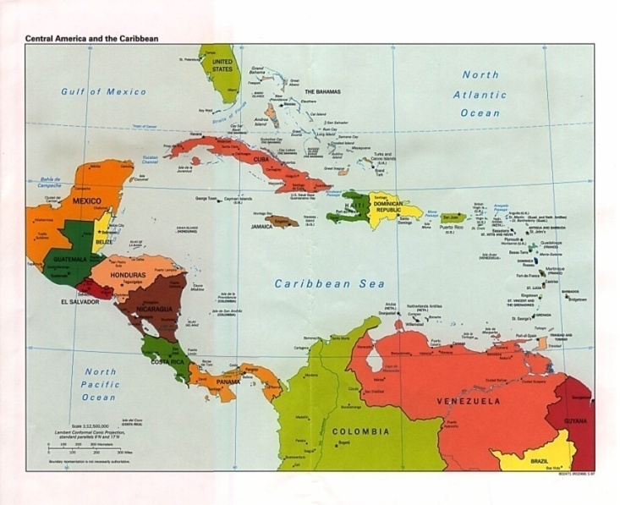
How Did U.S. Acquire Rights to Build the Canal?
Hay-Bunau-Varilla Treaty
signed w/ Panama in 1904
Panama Canal Timeline:
1) 1903: U.S. negotiated
treaty w/ Colombia (Panama part of)
2) Colombian gov’t stalled treaty demanding more
money
3) Roosevelt impatient – supported Panama’s revolt
4) U.S. recognized Panama’s independence,
negotiated treaty w/ Panama ($10 mill; $250,000 yearly lease for 10 mile wide strip)

Slide 33
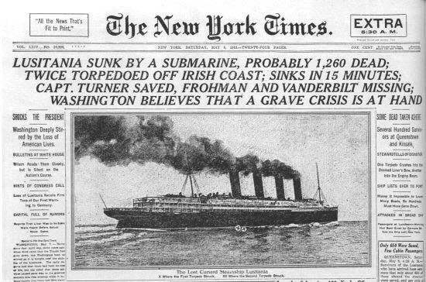
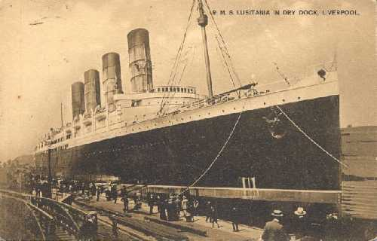
American Enters WWI: British passenger liner Lusitania
128 Americans died

Slide 34
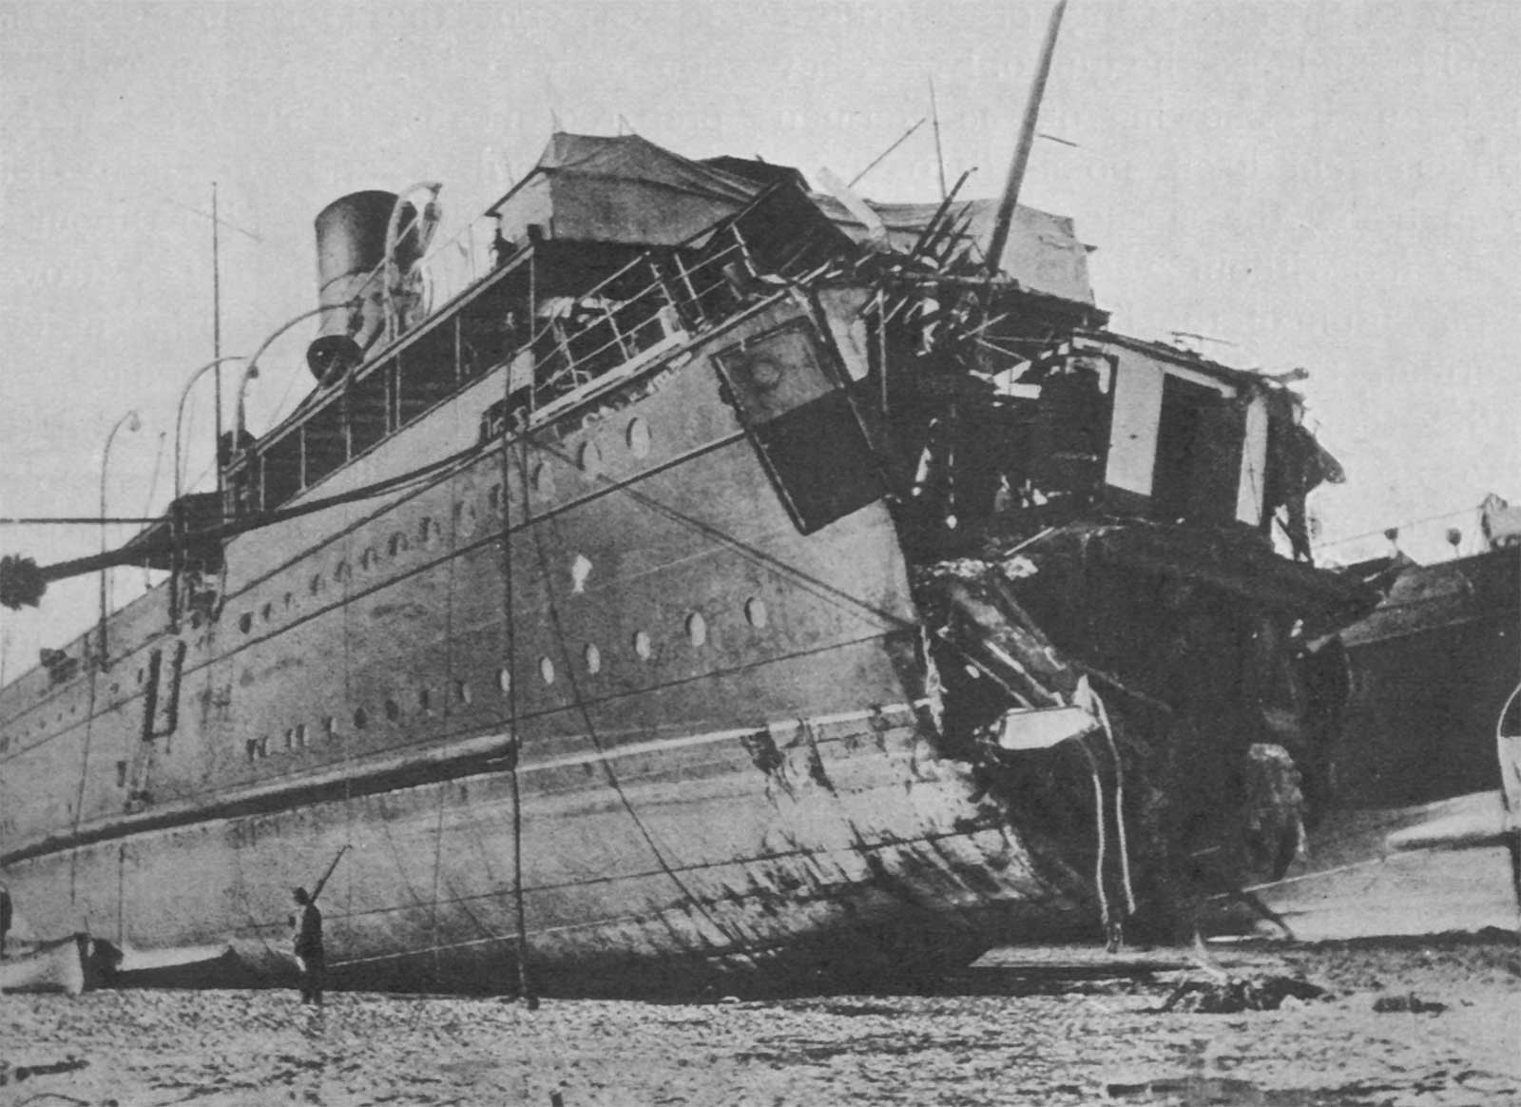
American Enters WWI: French passenger ship Sussex & Sussex pledge

Slide 35
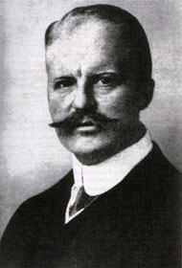
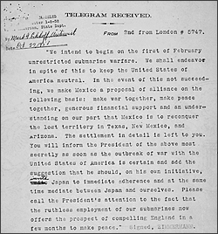
American Enters WWI: Zimmerman Telegram
German Foreign Minister Arthur Zimmerman
Telegram sent to Mexico asking Mexico to declare war on the U.S.

Slide 36
America enters WWI: Zimmerman Telegram
German foreign minister Arthur Zimmerman sent telegram to Mexico with this proposal:
  Mexico should declare war on the U.S. if they declare war on Germany
  In return, if Germany won war, they would give Mexico back Texas, New Mexico, and Arizona (lands lost in Mexican-American War)
  Mexico declined the proposal, but when Germany again announced unrestricted submarine warfare against Great Britain, the U.S. declared war on Germany on April 6, 1917

Slide 37
WWI Home Front
Selective Service Act –
  passed by Congress in 1917; authorized draft of men for military service; 2.8 million drafted, 4.8 million served
Women –
  won right to vote; moved into the workforce to replace men who were fighting; served as nurses
Government Responses to Opposition:
  Espionage Act (1917) - severe penalties for anyone involved in disloyal or treasonable activities or interfering with the war effort
  Sedition Act (1918) – illegal to use disloyal or abusive language about American government, Constitution, or military; Socialist leader Eugene V. Debs (ARU) imprisoned for anti-war speech

Slide 38
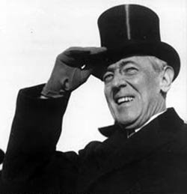
Woodrow Wilson’s Fourteen Points
Fourteen Points - Wilson’s list of terms for resolving WWI and future wars
Key ideas:
  “peace without victory”
  open diplomacy
  freedom of seas and free trade
  move toward ending colonialism
  self-determination
  League of Nations

Slide 39
America Rejects the Treaty
Senate’s issues with the Treaty of Versailles:
  concerned about the League of Nations
  afraid the treaty could lead the U.S. into a war without the consent of Congress
The United States did NOT ratify the treaty to join the League of Nations.
U.S. foreign policy after rejecting the treaty – isolationism

Slide 40
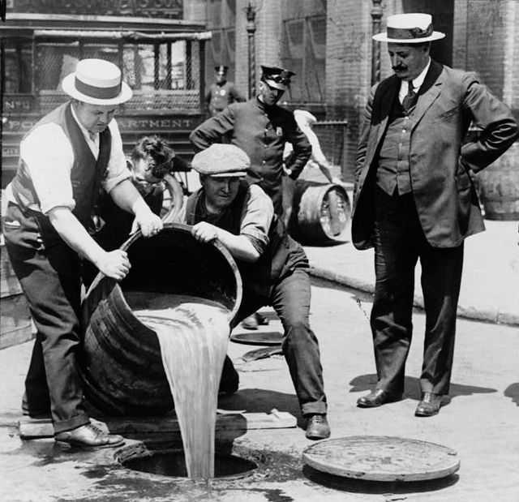
Prohibition – Eighteenth Amendment
Prohibition – the banning of alcoholic beverages
1919 states ratified Eighteenth Amendment – forbade the manufacture, distribution & sale of alcohol in the U.S.

Slide 41
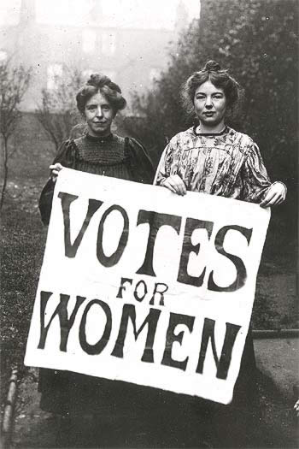
Nineteenth Amendment
Approved by Congress in 1919
Gave women the right to vote

Slide 42
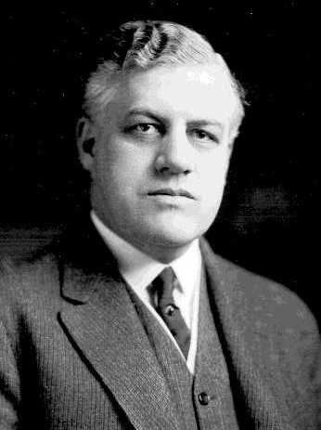
The Red Scare
Red Scare – fear of communists & radicals thought to be planning revolution in U.S.
Attorney General A. Mitchell Palmer led raids against suspected radicals & foreigners using Espionage & Sedition Acts
Palmer & agents accused of using torture to obtain intelligence & collect evidence
General A. Mitchell Palmer – leader of the Palmer Raids

Slide 43
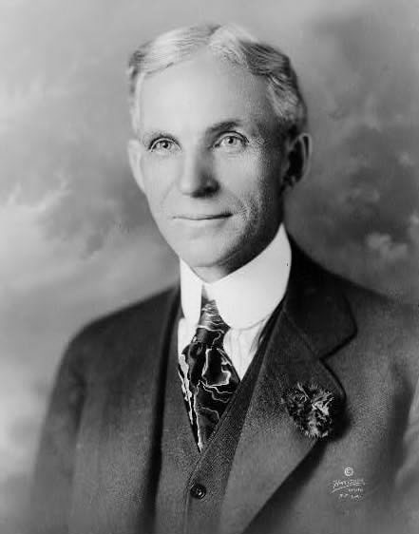
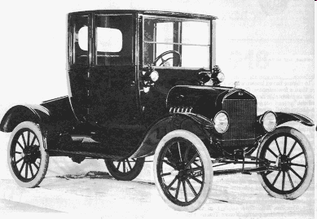
Henry Ford’s Model T
Henry Ford: responsible for much of America’s economic growth
1908 Model T – made cars affordable for ordinary Americans by:
  Mass production – used on a larger scale (thousands of parts)
  Assembly Lines – opened large factories (esp. in Detroit) and put cars on moving belts; workers added interchangeable parts; reduced manufacture time from 12 hours to 90 minutes

Slide 44
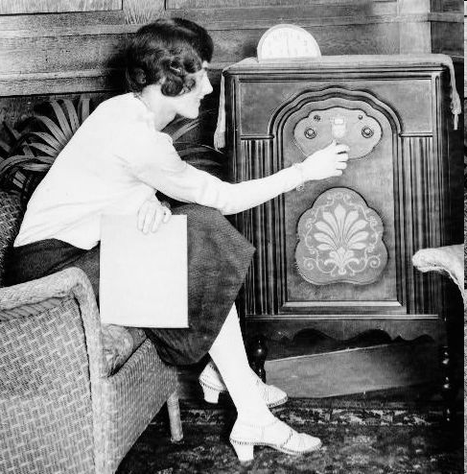
Radio
1920s radios became widespread
news & entertainment broadcasts began
increased the speed with which people gained information
increased national unity

Slide 45
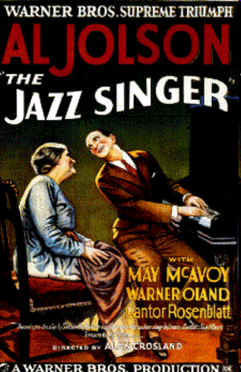
Movies
1920s movies became popular
1927 the first movie with sound, The Jazz Singer
movies with sounds called “talkies”

Slide 46
The Harlem Renaissance
Renaissance is Latin for
“rebirth”
What was the Harlem Renaissance?
period of “rebirth” for African American culture
During this period, African American novelists, poets, and artists celebrated their culture

Slide 47
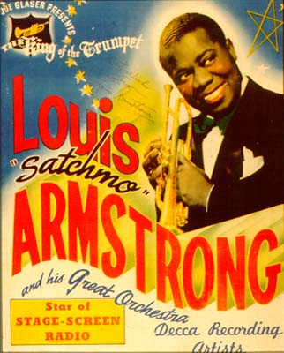
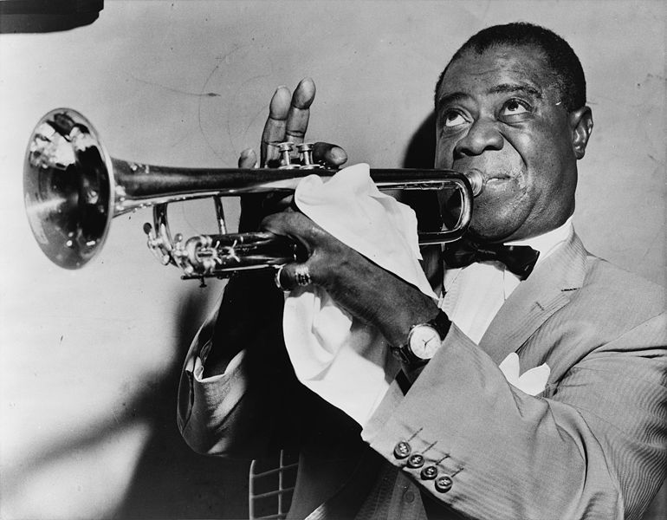
Louis Armstrong
trumpet player – famous for jazz music
nicknamed “Satchmo”
known as the “ambassador of jazz” – traveled to Africa, Asia, & Europe
also pioneered “scat”

Slide 48
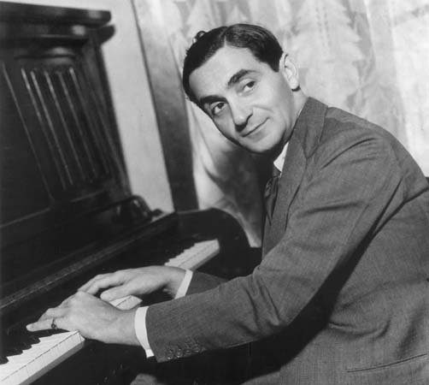
Irving Berlin
songwriter & composer
inspired by jazz music
songs written by Berlin:
  “God Bless America”
  “Blue Skies”
  “I’ve Got My Love to Keep Me Warm”
  “White Christmas”
  “Happy Holiday”

Slide 49
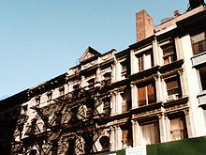
Tin Pan Alley
collection of New York City music publishers & songwriters that dominated popular music
composers like Irving Berlin
commercialization of music --jazz and blues pop-songs & dance numbers popularized
sheet music manufactured for commercial sale & profit
Buildings housed sheet-music publishers that were the center of American popular music in early 1900s.

Slide 50
Causes of the Depression
Under Consumption
Stock Market Speculation
Overproduction
The Great Depression

Slide 51
The Dust Bowl
Dust Bowl – central & southern Great Plains during 1930s when region suffered dust storms
Causes:
  Severe drought
  Over farming - farmers plowed the plains & eliminated protective layer of grass
  High winds - layers of top soil blown away, leaving dunes of grit & sand

Slide 52
Impact on Americans
Unemployment soared – 25-30% of work force
Bank failures – ¼ of nation’s banks
Business failures – 85,000
Homelessness, hunger widespread
  fed in breadlines, received assistance from charities
  evicted from homes & formed Hoovervilles – makeshift shantytowns of tents & shacks built on public land or vacant lots
Farm foreclosures

Slide 53
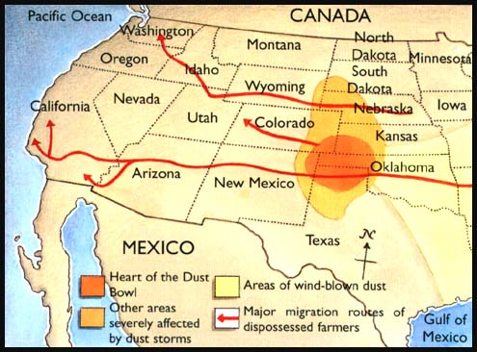
The Dust Bowl
Areas Affected:
  Great Plains
Results:
  Dust storms caused people to leave
  Dust Bowl refugees known as “Okies”
  Results of the migration: rural states lost population, large cities gained more people

Slide 54
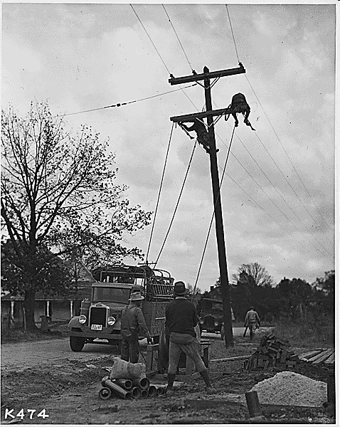
New Deal: TVA
(1933)
Name: Tennessee Valley Authority
Description:
  built dams on TN River to provide hydroelectric power, flood control, & prevent soil erosion
  created jobs & provided cheap electricity for rural areas
  still functioning today

Slide 55
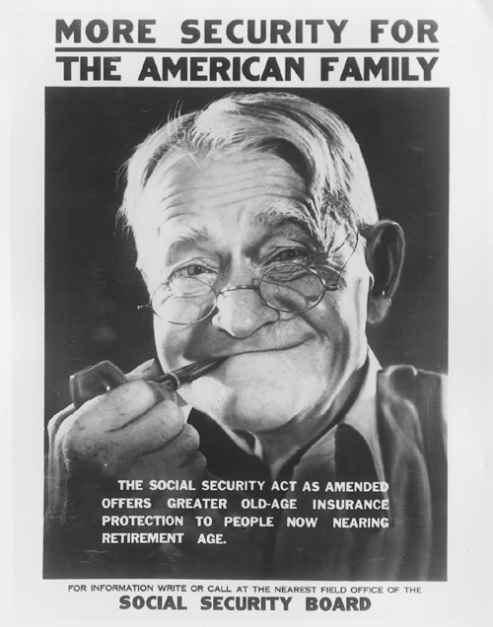

SSA
(1935)
Name: Social Security Act
Description:
  provide security in the form of regular payments to people who could not support themselves
  funded by payroll tax
  3 types of payments:
        old-age pensions
        unemployment insurance
        aid for dependent children & disabled

Slide 56

Wagner Act
(1935)
guaranteed unions collective bargaining rights
outlawed discrimination against workers due to union membership/activities
set up NLRB to enforce law’s provisions

Slide 57

FDR & Eleanor
FDR depended on Eleanor
She traveled & interacted w/ American people serving as FDR’s “eyes & ears”
1933 Bonus Army incident; FDR sends Eleanor instead of army

Slide 58


Eleanor
offered advice on policy issues
advocated public health & education, promoted arts, addressed flood control
gave money she earned to charity
Eleanor changed the office of First Lady from a ceremonial role to a position of action & involvement.

Slide 59

Challenges to Roosevelt’s “New Deal”
LA Senator Huey P. Long criticized New Deal - wanted more help for poor
proposed “Share Our Wealth” program - high taxes on wealthy & large corporations; redistribute their income to poor
made enemies because he ruled state of LA like he owned it – 1935 political enemy assassinated him

Slide 60
FDR’s “Court Packing Bill”
Supreme Court challenges the New Deal:
FDR upset by Supreme Court striking down New Deal programs (AAA)
Roosevelt proposes “packing the court”:
asked Congress to increase size of Supreme Court (6 more members) – why?
stated reason: many justices elderly & overworked; relieve the burden on them
unstated reason: app’t more liberal justices who would support the New Deal & sway court in FDR’s favor

Slide 61
Reaction to FDR’s Plan
Critics react to Roosevelt’s plan:
negative public reaction; bill did not pass
Accused FDR of trying to increase Pres power & upset balance (separation) of powers
FDR is weakened politically:
FDR lost political support; public less willing to accept new programs
In long run, Court became more accepting of New Deal

Slide 62
United States’ Action during WWII
majority of Americans opposed U.S. intervention
Congress passed the Neutrality Acts of 1935, 1936, and 1937 – imposed restrictions on Americans during times of war
example: prohibited sailing on ships owned by nations at war, prevented Americans from making loans to nations at war or selling them weapons

Slide 63
Another Neutrality Act
Roosevelt declared American neutrality but was anti-Nazi
convinced Congress to pass the Neutrality Acts of 1939 – included a cash-and-carry provision – nations at war could buy goods & arms in the U.S. if they paid cash & carried merchandise on their ships

Slide 64

African Americans Gain Civil Rights
Double “V” campaign:
need for victory against dictators abroad & discrimination in U.S.
A. Philip Randolph:
organized protest march on Washington, D.C. & convinced FDR to issue Executive Order 8802 – assured fair hiring practices in jobs funded w/ gov’t money & est. Fair Employment Practices Committee

Slide 65

Japan Attacks Pearl Harbor
Dec. 7, 1941, Japanese planes attacked Pearl Harbor in the Hawaiian Islands.
Dropped bombs on American ships at naval base.
in less than two hours, Japan destroyed most of the U.S. Pacific fleet.
more than 2,000 sailors & 68 civilians killed

Slide 66
Challenges to Civil Liberties
Roosevelt ordered 110,000 Japanese Americans into “relocation camps” – internment
  Moved to Utah, California, Arizona, Wyoming, Arkansas, & Idaho
  Had to sell homes, businesses, & belongings
Over 17,000 Japanese Americans served in Army units even while friends & families were in camps
Korematsu v. U.S. decision upheld internment

Slide 67


Roosevelt Inches Toward Involvement
1941, Congress passed Lend-Lease Act
allowed Roosevelt to sell or lend war supplies to any country whose defense he considered vital to U.S. safety

Slide 68
WWII: Battle of Midway
Midway
Date: 1942
Description: Japan (under Admiral Yamamoto) attempted to destroy American aircraft carriers in Pacific; Navy code breakers intercepted message & under U.S Admiral Chester Nimitz’s leadership U.S defeated Japan; * turning point of the war in the Pacific – stopped Japan’s advance

Slide 69

WWII: D-Day
Operation Overlord (D-Day)
Date: June 6, 1944
Description: the Allies led by Gen. Dwight D. Eisenhower landed on the beaches of Normandy, France; high American causality rates at Omaha beach; *Allies successful at gaining ground in France

Slide 70
World War II Allied Conferences
Potsdam (July ‘45)
Leaders: Harry S. Truman (U.S.), Clement Atlee (Britain), Stalin (Soviet Union)
Decisions Reached: decided to divide Germany into four zones of occupation: Soviet, American, British, & French; free elections for Poland; Soviets’ right to claim reparations for war damages from Germany

Slide 71

Potsdam: Division of Germany

Slide 72


Supporting War Effort
Cost of WWII: $330 billion
Financed: imposed a 5% tax on working Americas; Americans bought war bonds
Rationing: Americans were issued coupon books that limited the amount of certain goods they could buy

Slide 73

Women Work for Victory
Women’s contribution to the war:
worked in heavy industry, need for workers ended common practice of women quitting their jobs once married
“Rosie the Riveter”

Slide 74

The Manhattan Project
Manhattan Project – code-name
Project leaders: General Leslie Groves & physicist J. Robert Oppenheimer
Los Alamos, New Mexico
Truman made decision to drop 2 atomic bombs on Japan to save American lives

Slide 75

1947: Truman Doctrine announced
Truman Doctrine – Truman promised to aid nations struggling against communist movements

Slide 76

1948: Marshall Plan authorized
Sec. of State George Marshall’s plan to help Europe recover from war
Marshall Plan – economic aid for nations in Western Europe - U.S. gave money (grants & loans), food, fuel

Slide 77

1947: Kennan outlines Containment Policy
Kennan – American diplomat & authority on Soviet Union
Containment policy – keep communism contained within its existing borders; became America’s policy

Slide 78


1949: People’s Republic of China proclaimed
Mao Zedong led communist forces in China against Nationalist leader Chiang Kai-shek
Mao defeated nationalist forces & renamed China People’s Republic of China – communist nation
Truman Adm. blamed for not providing enough support
Mao Zedong

Slide 79

1950: Korean War begins
Korea – split at 38th parallel; North was communist, South noncommunist
N. Korea attacked S. Korea & took S. Korea’s capital, Seoul
UN Security Council voted to aid S. Korea; Truman ordered U.S. troops to S. Korea

Slide 80

1953: Korean War ends
stalemate until 1953
Eisenhower elected U.S. President – promised to end war
cease-fire signed, division at 38th parallel restored – still in effect today

Slide 81

1950: Another Red Scare - McCarthyism
Senator Joseph McCarthy claimed State Department was full of communists
McCarthyism – extreme, reckless charges of disloyalty; discredited real concerns about communists in the U.S.
Red Scare declined by 1954

Slide 82


1961: Bay of Pigs invasion
1959 Fidel Castro set up a communist gov’t in Cuba
Eisenhower had approved CIA plan to invade Cuba & overthrow Castro; recruited Cuban exiles & trained in Guatemala
Kennedy executed plan – CIA-led force of Cuban exiles attacked Cuba
plan failed & many turned Cuban Americans against Kennedy

Slide 83


1962: Cuban Missile Crisis
U.S. discovered Soviets building nuclear missile sites in Cuba to protect Castro from an American invasion
major East Coast cities would be in range
Kennedy demanded removal of missiles & set up blockade of Cuba to prevent Soviets from completing bases
Khrushchev removed missiles
Range of Cuban missiles

Slide 84

1968: Vietnam War – Tet Offensive
Tet Offensive – Vietcong’s coordinated attack on S. Vietnam; 36 provincial capitals, 5 major cities, & U.S. embassy in Saigon
American & S. Vietnamese forces stopped offensive, but demonstrated communists had not lost will or ability to fight
President Johnson announced plan to pursue peace, not victory; would not run for a second term

Slide 85

Baby Boom
increase in births between 1945 – 1964
families had put off having families during depression & war, but started having children when soldiers returned after WWII

Slide 86


Levittown
William Levitt – mass produced suburban homes
Levittown – New York suburb that offered affordable homes ($8,000 each); demand increased & other Levittown's built

Slide 87

Interstate Highway Act
Eisenhower’s Interstate Highway Act – authorized spending $32 billion to build 41,000 mi. of highway

Slide 88


Election of 1960
Kennedy (D) v. Nixon (R)
his Catholicism worked against him
first televised Presidential debates – benefited Kennedy & probably swayed election in his favor

Slide 89

1957: Sputnik launched by Soviets & U.S. reaction
Sputnik I - Soviet space satellite
U.S. reaction
  Congress approved the National Defense Education Act - $1 billion program to produce more scientists and teachers of science
  Congress created National Aeronautics and Space Administration (NASA) to plan space-related projects

Slide 90

Truman’s desegregation of the military
Date: 1948
Description:
  Background: Truman appt. Committee on Civil Rights to investigate race relations; Truman attempted to implement suggestions, but Congress did not support
  Truman used executive power to order the desegregation of military

Slide 91

Jackie Robinson breaks the color line
Date: 1947
Description: Jackie Robinson joined the Brooklyn Dodgers becoming the first African American to play baseball in the major leagues

Slide 92

Brown v. Board of Education of Topeka, KS
Date: 1954
Description: overturned the “separate but equal” principle established by 1896 Plessey v. Ferguson case; U.S. Supreme Court decided segregated public education violated the U.S. Constitution

Slide 93

King’s arrest & Letter from a Birmingham Jail
Date: 1963
Description: King joined protesters in Birmingham and was arrested; from jail he wrote a letter explaining why civil rights activists were tired of waiting for change

Slide 94



March on Washington &
“I Have a Dream” Speech
Date: 1963
Description: organized by NAACP, SCLC, & SNCC; 200,000 demonstrators marched on capital to put pressure on Congress to pass a new civil rights bill
King gave his “I Have a Dream” speech in front of the Lincoln Memorial

Slide 95

Civil Rights Act of 1964
Description: signed by Pres. Johnson (Kennedy assassinated Nov. 1963)
banned segregation in public accommodations
gave federal gov’t ability to make state & local boards desegregate their schools
allowed Justice Dept. to prosecute individuals who violated people’s civil rights
outlawed discrimination in employment – est. Equal Employment Opportunity Commission

Slide 96

Voting Rights Act of 1965
Description: banned literacy tests & gave the federal gov’t the power to oversee voting registration & elections in states that had discriminated against minorities

Slide 97

Warren Court
Chief Justice of Supreme Court - Earl Warren
nominated by Eisenhower
liberal rulings- helped expand individual rights
Brown v. Board of Ed. (’54)
Miranda v. Arizona (‘66)
  Miranda Rights – accused criminals had to be informed of his/her Fifth (remaining silent) & Sixth Amendment rights (speed, public trial before jury) before being questioned

Slide 98

Johnson’s Domestic Highlights
“Great Society” – focused on health care, education, environment, discrimination, & poverty
  Medicare (hospital insurance for people over 65)
  Medicaid (low-cost health insurance for poor)

Slide 99


Martin Luther King’s assassination
Date: 1968
Description: assassinated in Memphis, TN on April 4th while on the balcony outside his motel room; James Earl Ray, a white ex-convict was charged with the murder

Slide 100


Robert Kennedy: Assassination
Robert Kennedy (RFK):
  JFK’s little brother
  politician & U.S. Attorney General
  civil rights activist – Civil Rights Bill
  opposed Vietnam War
  1968 Presidential Candidate
Assassination
  shot June 5, ‘68 (2 mo. after MLK) by Sirhan Sirhan, Palestinian immigrant
Democratic Nat’l Convention in Chicago (‘68) – debate Vietnam
  Antiwar protesters are beaten by Police outside convention center

Slide 101

Formation of SCLC
Date: 1957
Description: After Montgomery Bus Boycott, King & minister Ralph Abernathy est. Southern Christian Leadership Conference (SCLC) to fight for civil rights
Membership: mostly southern African American ministers
promoted nonviolent resistance

Slide 102

Formation of SNCC
Date: 1960
Description: Ella Baker, granddaughter of slaves, helped young civil rights activists form the Student Nonviolent Coordinating Committee (SNCC)
Goal: create grass-roots (community) movement that involved all classes of African Americans in pursuing equality

Slide 103


Women’s Rights Movement
1960s & ‘70s
feminism – political, social, & economic equality of men & women
Origins: began 1840s – Declaration of Sentiments, 1st feminism wave in ‘20s -Nineteenth Amendment
Nat’l Organization of Women
  Goals: pass Equal Rights Amend. to guarantee gender equality; protect reproductive rights
Roe v. Wade (‘73) – right to legal abortions in first 3 mo. of pregnancy
Betty Friedan
The Feminine Mystique
Gloria Steinem

Slide 104


Cesar Chavez &
United Farm Workers’ movement
Chavez – migrant farmworker & Latino activist, fought for rights for farm laborers (often exploited) – better working conditions
United Farm Workers – used nonviolent tactics; started
worker’s strike &
consumer boycott of grapes
successful – ’75 CA passed
law requiring collective
bargaining between
growers & union reps.

Slide 105


Environmental Movement
Rachel Carson – biologist, wrote Silent Spring (‘62) – described deadly impact pesticides were having on birds & other animals; Congress restricted use of pesticide DDT (eagles)
Earth Day – April 22, ‘70 nationwide protest org. by WI senator Gaylord Nelson; 20 million Americans participated
EPA – gov’t agency created by Congress in ’70 to clean up & protect the environment

Slide 106

Election of 1964
L. Johnson (D) v. Goldwater (R)
did not seek
reelection in
‘68 due to
divisions over
Vietnam
Goldwater marks
rise of the
Conservative
movement

Slide 107

1972: Nixon visits China
After Chinese communist revolution, U.S. never formally recognized People’s Rep. of China; Nixon wanted to - benefit U.S. economically (trade) & distance relationship b/w China & Soviet Union
Nixon made an official state visit to China – successful at opening relations w/ China
full Diplomatic relations established b/w U.S. & China in 1979
President Nixon meets with China’s Communist Party leader, Mao Zedong

Slide 108
Nixon & Watergate
Watergate Scandal
  attempted break-in of Dem. Party headquarters (Watergate complex)
  connected to Nixon
  reelection committee tried to bug office & record conversations of political opponents
Nixon resigned in 1974; Ford became President and pardoned Nixon

Slide 109
Affirmative Action
affirmative action – policy that gives special consideration to women & minorities to make up for past discrimination; ’70s - special focus on employers & schools
Bakke decision:
  Regents of the University of California v. Bakke (‘78)
  Medical school reserved spots in class for minorities
  Bakke (white, stronger academic record) not accepted & claimed racial discrimination
  Supreme Court required Bakke’s admission but did not overturn affirmative action

Slide 110

Carter’s Foreign Highlights
Camp David Accords (’78) - peace treaty between Egypt & Israel, Egypt recognized nation of Israel & Israel withdrew troops from Sinai Peninsula
Iranian Revolution (‘79) – opposition to Shah (emperor) of Iran led to the Ayatollah Khomeini seizing power, Shah fled to U.S. for cancer treatment
Iran-Hostage Crisis (Nov ’79-Jan ’81) – Iranian radicals responded by invading U.S. embassy & taking 66 Americans hostage, held for more than a year before being released – after Reagan’s election

Slide 111

Reagan’s Domestic Highlights
“Conservative Revolution”
“Reaganomics” – supply-side economics adopted – reduce taxes so people will work more, have more money to spend = economic growth

Slide 112
Reagan’s Foreign Highlights
Iran-Contra Scandal (’86) – U.S. sold weapons to Iran in ’85; in exchange, Iran promised to pressure terrorist groups in Lebanon to release Am. hostages – plan not successful & contradicted policy of not negotiating w/ terrorists; used money from weapon sales to fund Contras (anticommunists) in Nicaragua – previously banned by Congress

Slide 113

1989: Berlin Wall falls &
E. European nations throw off Communism
Berlin Wall blocked travel from communist East Berlin to democratic West Berlin
1989 – East Germany’s communist government fell; Berlin wall torn down
Communists also lost power in Poland, Hungary, Czechoslovakia, Bulgaria, & Romania in 1989; Albania in 1990; Yugoslavia in 1991
East German Border guards demolishing a section of the Berlin Wall

Slide 114

1991: Soviet Union collapses
Communist Party lost power & Soviet Union separated into 15 independent republics
Cold War ended (1945-1991)

Slide 115

Clinton’s Highlights
Free trade reappeared:
  NAFTA (North American Free Trade Agreement) (‘92) – called for the gradual removal of trade restrictions among the U.S., Canada & Mexico
Scandals:
  Lewinsky – Clinton’s affair with a White House intern, lied under oath about affair
Impeached in ’98 - acquitted

Slide 116

Election of 2000
G W Bush (R)
v. Gore (D)
Disputed election in Florida (25 Electoral College votes); Bush awarded victory in FL & therefore won Electoral College majority (by 1 vote) (Gore won popular vote)

Slide 117
September 11, 2001
Terrorist attack by Osama bin Laden’s al Qaeda network
More than 3,000 Americans died
Bush declares “war on terrorism”
American intervention:
  Afghanistan: Bin Laden believed to be hiding in Afghanistan where Taliban government let them run terrorist training camps; U.S. overthrew Taliban gov’t; held free elections & wrote a new constitution
  Iraq: believed Saddam Hussein was building & stockpiling Weapons of Mass Destruction (WMD); 2003 Operation Iraqi Freedom – U.S. forces invade; 2005 Iraq wrote new constitution

