Slide 1
Macro Measures Unemployment
Copyright
ACDC Leadership 2015
1

Slide 2
The Business Cycle Quiz
Identify the parts of the business cycle 1-7
Real GDP
Inflation
#5
Deflation
Peak
#6
#1
Real GDP
#2
Trough
#7
Full Employment
#3
#4
Time
Contraction
Expansion

Slide 3
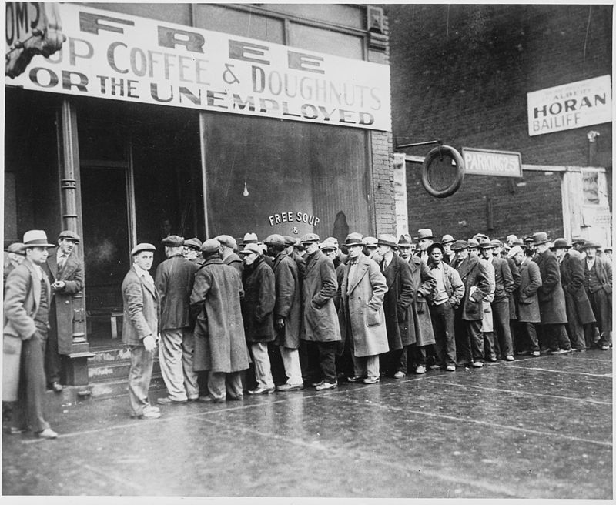
Goal #2
Limit Unemployment
Copyright
ACDC Leadership 2015
3

Slide 4
What is Unemployment?
Unemployment: People actively looking for job but not working.
Unemployment Rate: percent people in labor force who want a job but are not working.
Unemployment
Rate
# unemployed
x
=
100
# in labor force
Who is in the Labor Force?
Legal Age to work
Able and willing to work
Not institutionalized (in jails or hospitals)
Not in military, in school full time, or retired
Why is a stay at home mom not unemployed?
4

Slide 5
Notes:
C

Slide 6
Three Types of Unemployment
Copyright
ACDC Leadership 2015
6

Slide 7
3 Types of Unemployment
#1. Frictional Unemployment
Temporary unemployment (being between jobs)
Qualified workers with transferable skills.
Examples
High school or college graduates looking for jobs.
Individuals that were fired or quit and are looking for a better job.
Seasonal Unemployment
a specific type of frictional unemployment which is due to time of year and the nature of the job.
7

Slide 8
3 Types of Unemployment
#2. Structural Unemployment
Changes in the labor force make some skills obsolete.
These workers DO NOT have transferable skills and these jobs will never come back.
Workers must learn new skills to get a job.
Examples: VCR Repairman, Milkman
Technological Unemployment
Type of structural unemployment where automation and machinery replace workers
8

Slide 9
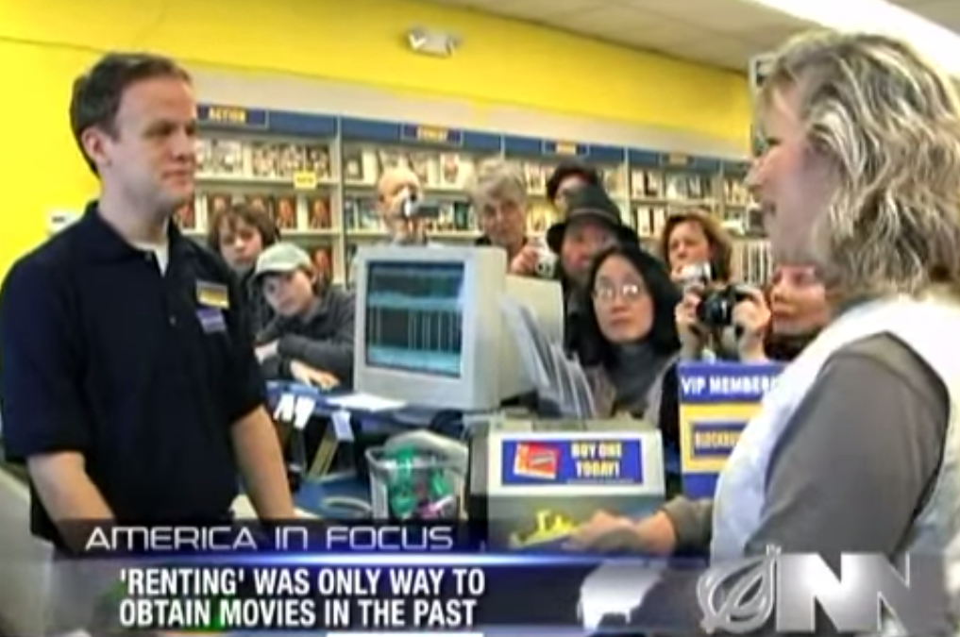
Some Jobs Disappear

Slide 10
3 Types of Unemployment
#3 Cyclical Unemployment
Unemployment caused from a recession
As demand for goods and services falls, demand for labor falls and workers are fired
This is sometimes called “demand deficient unemployment”
Examples
Steel workers laid off during recessions
Restaurant owners fire waiters after months of poor sales due to recession
High unemployment during the Great Depression
10

Slide 11
Natural Rate of Unemployment (NRU)
Many people assume that our goal is zero percent unemployment, but it’s not.
Why?
Copyright
ACDC Leadership 2015

Slide 12
The Natural Rate of Unemployment
There will always be people between jobs or replaced by technology. The economy is healthy if there is only frictional and structural unemployment.
Natural Rate of Unemployment (NRU)
Frictional plus structural unemployment.
Full Employment Output (Y)
The Real GDP that is created when there is no cyclical unemployment
The US is at full employment when there is
4% - 6% unemployment
12

Slide 13
Unemployment
and the Business Cycle
Real GDP
Real
GDP
Time
6+% Unemployment
4-6% Unemployment
Super low unemployment leads to inflation
Copyright
ACDC Leadership 2015
13

Slide 14
The Natural Rate of Unemployment in France and Germany is around 8–10%.
Why?
Some economists attribute the difference to more generous unemployment benefits in European countries
In the U.S. unemployment benefits last for 6 months
Unemployment benefits in some European countries are indefinite
The generous benefits reduce incentives to search for a job
Notes:
14
Unemployment benefits in the U.S. are often extended to 9 months or 1 year during periods of high unemployment.

Slide 15
Criticisms of the Unemployment Rate
The unemployment rate can misdiagnose the actual unemployment rate because of:
Discouraged Workers
Some people are no longer looking for a job because they have given up.
Underemployed Workers
Someone who wants more hours but can’t get them is still considered employed.
Race/Age Inequalities
The overall unemployment rate doesn’t show disparity for minorities and teenagers
Copyright
ACDC Leadership 2015
15

Slide 16
Are You Unemployed?

Slide 17
Econmovies
Episode 6: Back to the Future

Slide 18
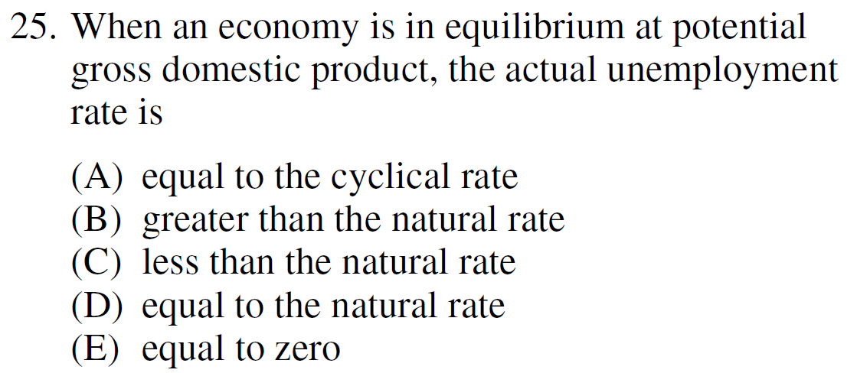
2013 Audit Exam
Notes:
D

Slide 19
2008 Audit Exam
Copyright
ACDC Leadership 2015
19
Notes:
C

Slide 20
2006 Practice FRQ
Copyright
ACDC Leadership 2015
20

