Slide 1
Colonial Foundations
How did English settlement and colonization develop during the 17th Century?

Slide 2
Rise of European Colonial Empires
1492 – Spain discovers new world
Conquers Aztecs in Mexico and Inca in Peru to plunder them of vast amounts of gold and silver.
Spain becomes richest country in Europe.
Soon followed by Portugal, France, Holland, and England

Slide 3
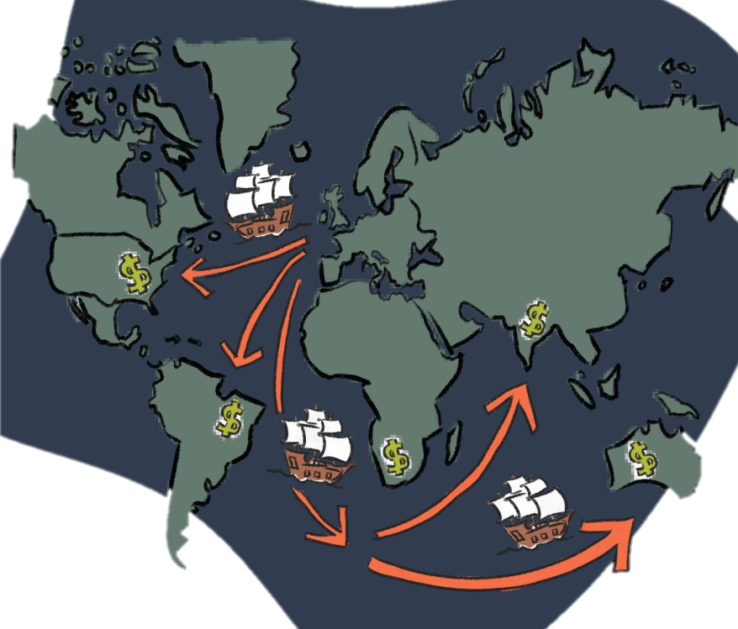
Mercantilism
Economic policy...Wealth is power, key to wealth is export more than import
European countries competed for world power and needed colonies to provide necessary raw materials.
Colonies' Role: provide raw materials (so mother country does not have to import from other nations) and markets for exports
Result = Favorable balance of trade for England

Slide 4
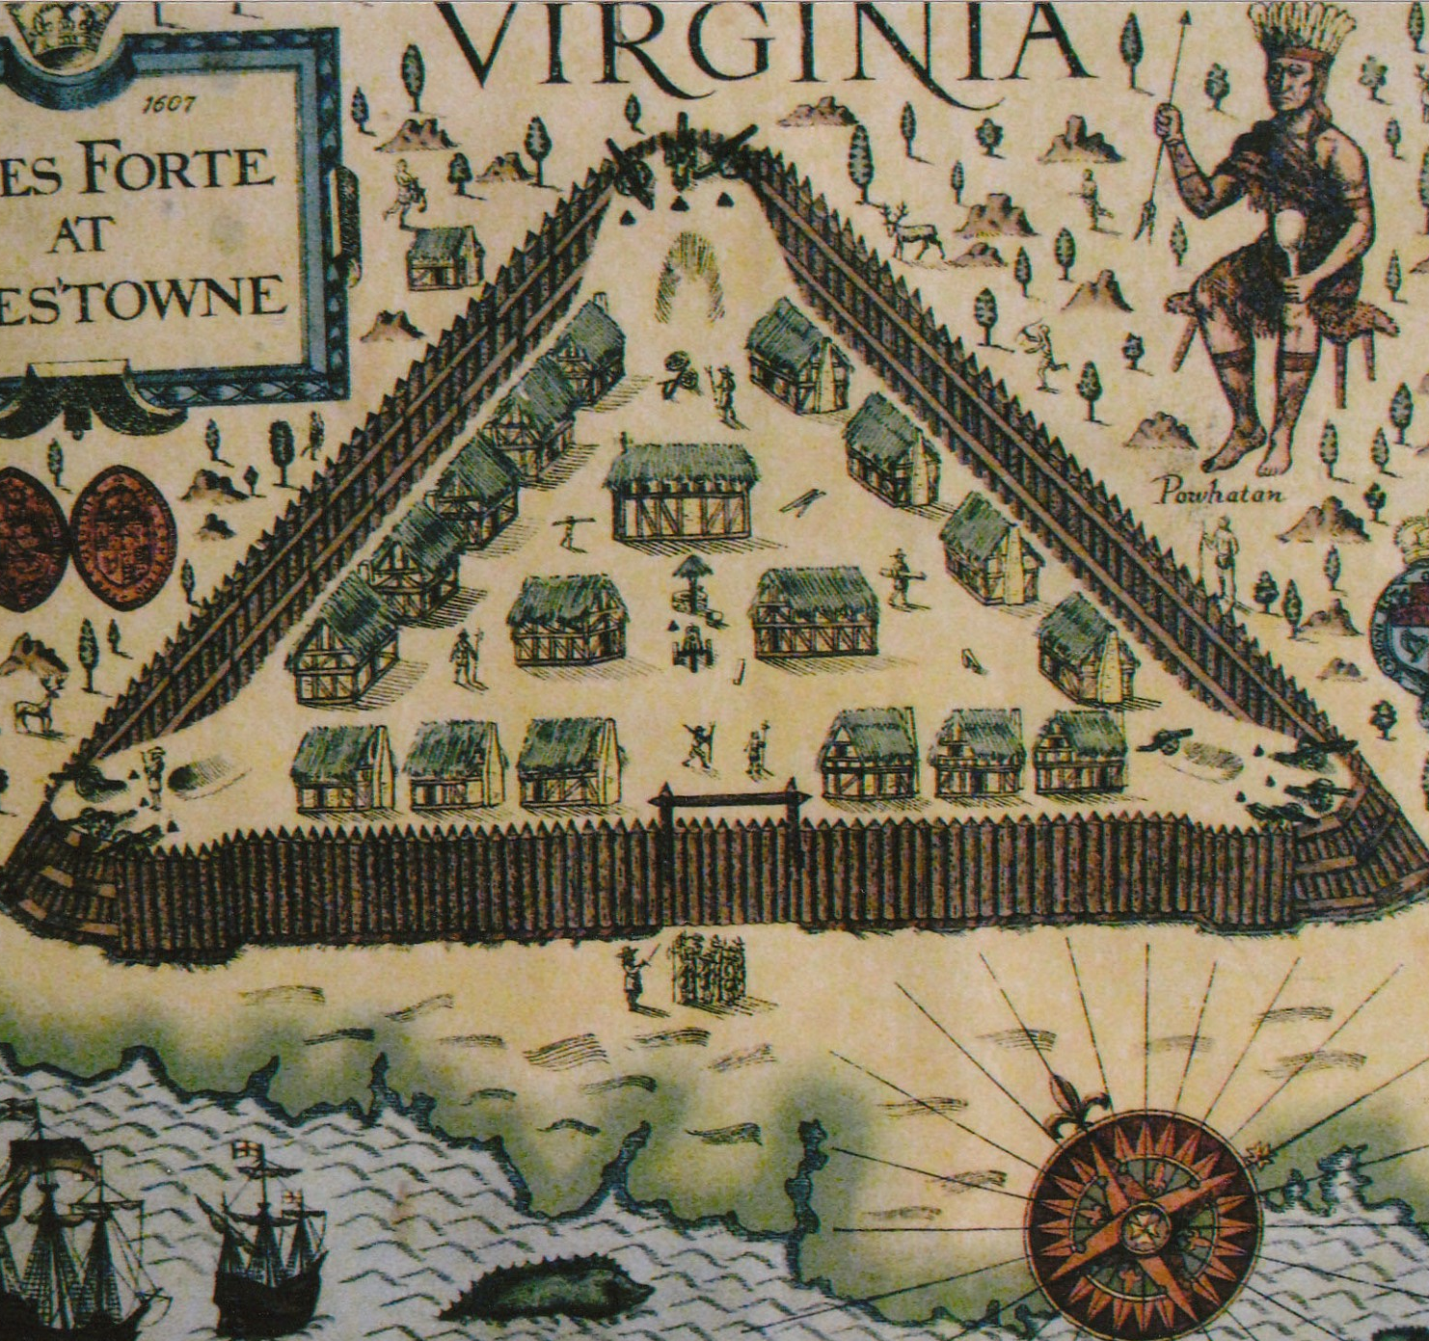
First Colony: Jamestown, Virginia
1607 – crude settlement set up near James river to search and collect GOLD, which was not there.
Settlers didn’t bring enough food and did not want to farm.
More than half of colonists died of starvation and diseases.

Slide 5
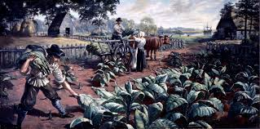
First Colony: Jamestown, Virginia
More colonists came to replace the dead and eventually John Rolfe brought tobacco seeds, which saved Jamestown.
London Company started headright system, indentured servants, and eventually slaves to work tobacco plantations.

Slide 6
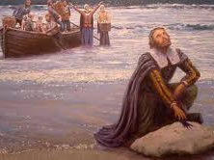
Second Colony: Plymouth
1620 Pilgrims – Separatists – Disagreed with Church of England and wanted to start colony to have more freedom of religion.
50 pilgrims traveled on Mayflower and landed on Plymouth in late November.
Colonists signed “Mayflower Compact”, agreeing to obey common laws. This was the earliest official form of self-government in the colonies.

Slide 7
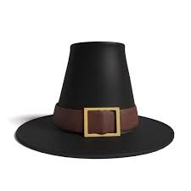
Second Colony: Plymouth
Pilgrims weren’t prepared for the harsh New England winter.
Half of Pilgrims died from disease and starvation in the first few months.
All of them may have died without help of local Indians.
Indians taught them how to plant corn and fertilize the soil with fish.

Slide 8
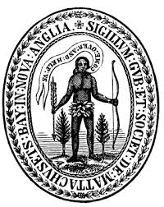
Third Colony: Massachusetts Bay
1630 – (years after arrival of Pilgrims) present day Boston
700 “Puritans” – wanted to purify the Church of England and feared persecution by King Charles.
Very strict religious beliefs.
Mandatory Church attendance.
Banned dancing, watching plays and other leisure activities.
Required children to learn to read the bible so they would continue fundamental puritan culture.

Slide 9
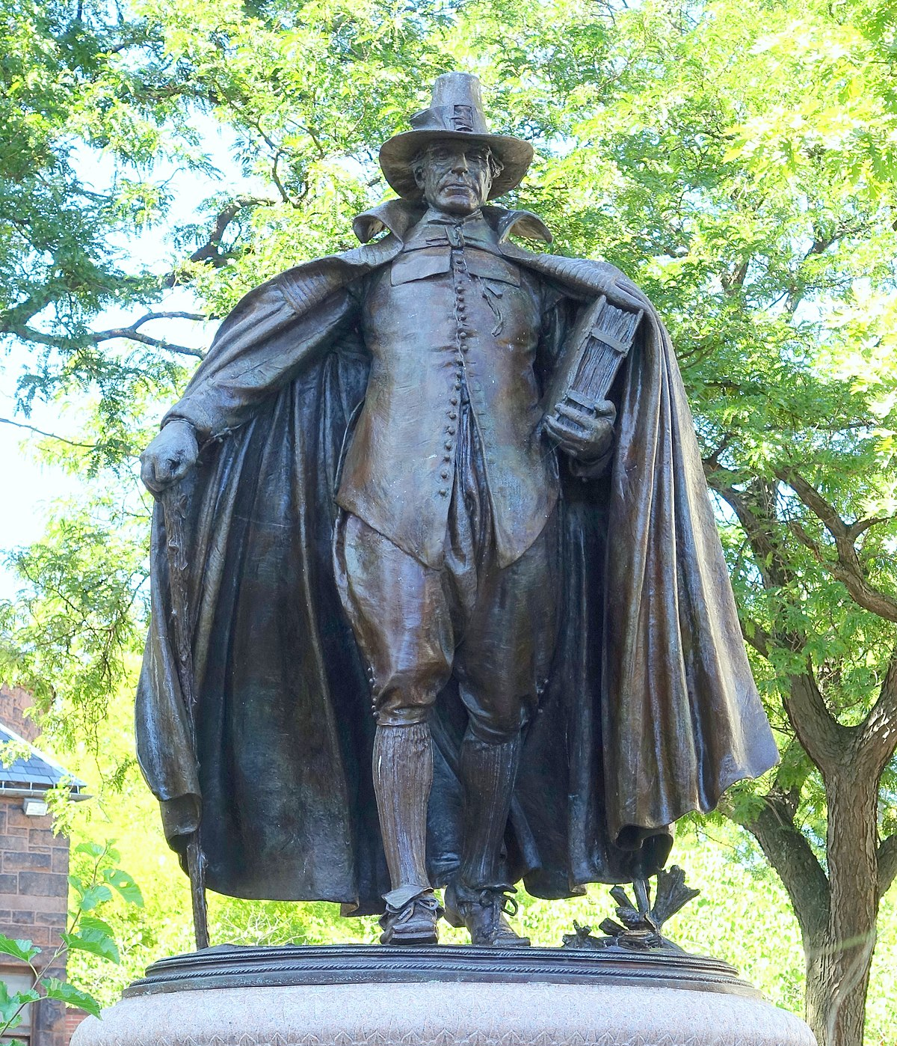
Third Colony: Massachusetts Bay
General Court – elected officials that governed the colony.
Only members of puritan congregation could vote or hold office.
Anyone that advocated for religious tolerance or diversity was shunned from puritan society and forced to leave the colony.

Slide 10
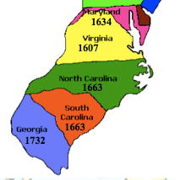
Southern Colonies
established mostly for economic reasons:
Virginia, North Carolina, South Carolina, Maryland, Georgia
Large farms and plantations growing tobacco, rice, indigo
Maryland established as refuge for catholics
Georgia as a buffer from Spanish Florida.
Agriculture and religious tolerance were common in the south

Slide 11
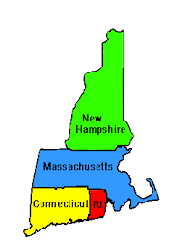
New England Colonies
Established mostly for religious reasons:
Massachusetts, Rhode Island, Connecticut, New Hampshire
Pilgrims and Puritans
Separatists and Fundamentalists
Society and Government revolved mostly around religious beliefs.

Slide 12
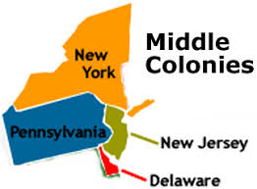
Mid-Atlantic Colonies
Established to prevent division of South and New England Colonies.
Pennsylvania, New York, Delaware, New Jersey
Originally established by Holland and called New Netherland
England conquered New Netherland - divided into colonies of New York, New Jersey, and Delaware.
Pennsylvania founded by William Penn as a home for Quakers.
Greater ethnic and religious diversity than other colonies because of immigration by Dutch and German settlers.

