Slide 1
Modern US Presidents
SSUSH22: Nixon, Ford, and Carter

Slide 2
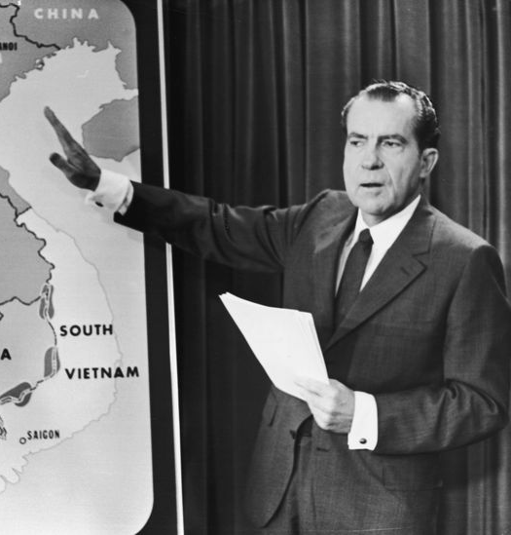
Richard Nixon Vietnamization
End the war in Vietnam honorably
- “peace with honor”.
replace American troops with South Vietnamese
end the draft.
increase bombing of North Vietnam
send U.S. troops into Cambodia.
led to large scale protests against the Vietnam War.
In 1970, National Guard fired on demonstrators at Kent State, killing four students and triggering massive demonstrations and closing of many college campuses across the country

Slide 3
Richard Nixon
Nixon’s International Policies
First U.S. President to visit communist China.
As a strong anticommunist, he could do this without being viewed weak on communism.
He hoped his visit to China would put pressure on North Vietnam.
Reopening of US relations with China paved the way for US diplomatic recognition of China and for China’s entry into the United Nations.
Also led to U.S. trade with China and China’s entry into the global economy.
Many historians see this step as Nixon’s greatest accomplishment as President.
Nixon also became the first President to visit Moscow. He sought a “détente,” or easing of tensions, with the Soviet Union.

Slide 4
Richard Nixon
Nixon’s Domestic Policies
Nixon cut many of Johnson’s Great Society programs but kept and even strengthened a few, including Medicare, Medicaid and the Head Start program.
Environmental threats became more evident in the postwar period. Congress passed a series of laws to protect the land, water, and air against pollution.
1970 - Nixon signed law creating the EPA (Environmental Protection Agency).
sets acceptable levels of pollution
punishes polluters
reviews major construction for environmental impacts.
Nixon also approved more laws protecting the environment and animals such as the Clean Water act, Clean Air Act, and Endangered Species Act.

Slide 5
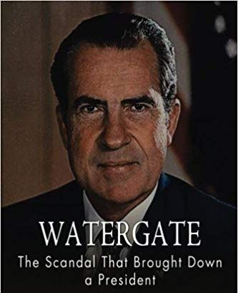
Richard Nixon
Watergate Scandal
During the Presidential campaign of 1972, burglars broke into Democratic Party headquarters at the Watergate Hotel to photograph documents and set wiretaps.
When they were caught, they were linked back to the White House.
Nixon tried to stop the FBI investigation and set up a “hush fund” to keep the burglars quiet.
Washington Post reporters kept the story alive in the press.

Slide 6
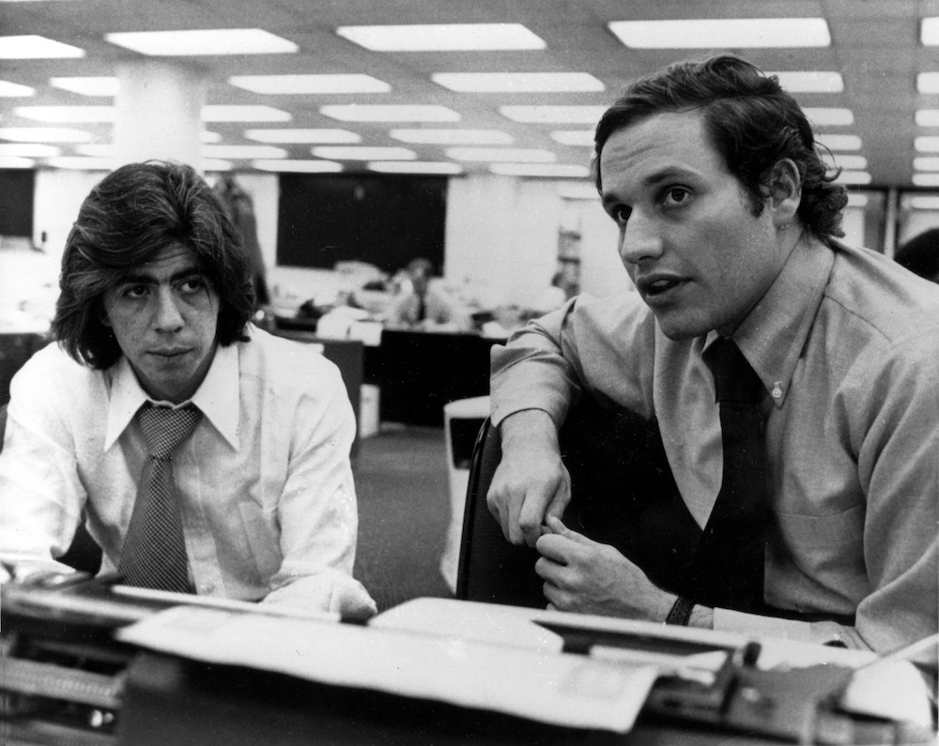
Richard Nixon Watergate Scandal
A special Congressional committee investigated the break-in and learned of the cover-up.
Nixon denied knowing anything about the break-in or cover-up.
When questioned by Congress, one of Nixon’s former staff members claimed Nixon knew about the cover-up and also revealed that Nixon had been secretly tape recording all of his White House conversations.

Slide 7
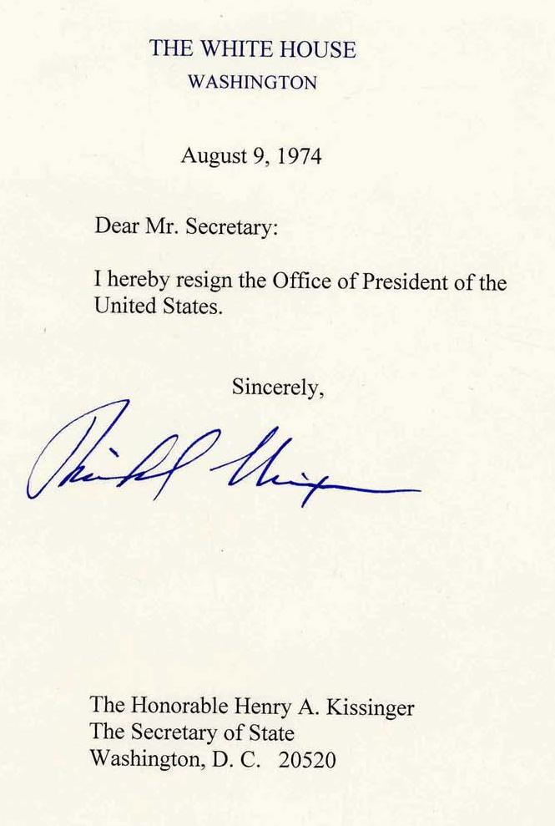
Richard Nixon Resignation
Congress and the independent counsel (lawyer) investigating Watergate asked for the tapes.
At first, Nixon refused to hand the tapes over, claiming “executive privilege.”
The Supreme Court denied this claim and Nixon was forced to hand over the tapes.
The tapes revealed that Nixon was behind the cover-up all along, prompting congress to begin impeachment process.
Nixon became the first President to resign.

Slide 8
Richard Nixon
Womens Rights Movement
Many educated, middle-class women, who wanted to liberate themselves from traditional gender roles, began the Women’s Liberation Movement, copying many of the tactics of the Civil Rights Movement.
In 1966, Betty Friedan (author of The Feminine Mystique) and other women organized the National Organization of Women (NOW), which became the voice of the movement.
The Women’s Rights Movement demanded social and economic equality with men. Some results include the Equal Education Act (Title IX), co-ed universities and classes, and affirmative action programs. Feminists also tried to pass the “Equal Rights Amendment.” The amendment was proposed by Congress, but it was not ratified by enough states

Slide 9
Gerald Ford
Congressman Gerald Ford was appointed Vice President when Spiro Agnew resigned as VP after a corruption scandal.
(he had accepted bribes as Governor of Maryland).
Ford became President after Nixon resigned.
President Ford pardoned former Nixon, which was unpopular and may have cost him the next election.
During Ford’s Presidency, Arab oil-producing countries in the Middle East boycotted the United States and raised their oil prices.
This led to rising prices (inflation) and unemployment in the United States. High inflation combined with high unemployment became known as “stagflation”.

Slide 10
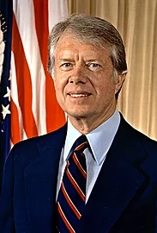
Jimmy Carter
1976 - Jimmy Carter, the Democratic candidate and a former Governor of Georgia, was elected President
After the Vietnam War and Watergate, many people no longer trusted politicians in Washington.
Carter ran as a Washington “outsider.” He told voters he would never lie to them.
Carter also wanted to take a more moral tone in U.S. foreign policy

Slide 11
Jimmy Carter – Camp David Accords
Egypt, in North Africa, was the nation with the world’s largest Arab population. Israel was a Jewish state in the Middle East created by the United Nations in 1948, in the aftermath of the Holocaust.
No Arab state had recognized Israel. Egypt and Israel had engaged in several wars. In 1967, Israel had occupied Egyptian territory in the Sinai Peninsula in the aftermath of one of these wars.
President Carter organized a meeting between Egyptian and Israeli leaders, and acted as a mediator.
They signed the Camp David Accords, which exchanged territory and agreed to normal diplomatic relations between the two countries.
This was the first time an Arab country had agreed to peace with Israel.

Slide 12
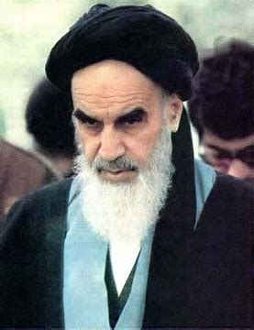
Jimmy Carter Iranian Revolution
In 1979, a popular revolution occurred in Iran. Demonstrators filled the streets of Tehran, the capital of Iran.
The Shah, the pro-Western ruler of Iran, fled the country.
Ayatollah Khomeini, a religious leader, returned from exile and established an Islamic theocracy (a country governed by religious leaders).

Slide 13
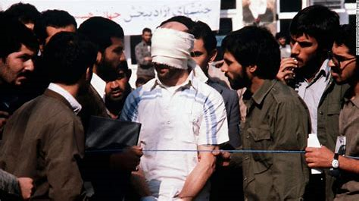
Jimmy Carter The Iran Hostage Crisis
When the US gave refuge to the Shah, who was seeking medical treatment, Iranian students took U.S. Embassy staff in Tehran as hostages.
They demanded that the United States send the Shah back to Iran.
President Carter was unable to get the hostages released through negotiations and an attempt at a daring raid failed.
The U.S. Embassy staff were held hostage for over a year.
They were released on the inauguration day of President Ronald Reagan.
The Iranian Hostage Crisis caused Americans to feel demoralized at their nation’s inability to rescue its own people.

Slide 14
Jimmy Carter – 1980 Presidential Election
President Carter cut relations with the Soviet Union when the Soviets invaded Afghanistan.
In addition to these problems overseas, President Carter was unable to lower the rate of inflation (high prices) and unemployment at home.
The rising price of oil led to frequent gasoline shortages.
With gasoline shortages, staggering inflation, and the Iranian hostage crisis, Carter lost the 1980 Presidential election to Republican candidate Ronald Reagan, a former movie star and Governor of California with conservative views.
Just as Reagan took office, Iran released its hostages. The Shah had died and Iran was now at war with Iraq. Iranian leaders wanted the United States to release Iranian assets it had seized in response to the hostage crisis.

