Slide 1
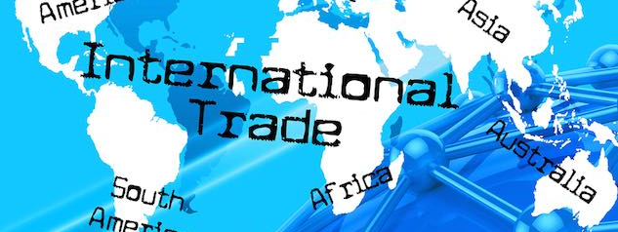
Trade Barriers and Free Trade
SSEIN2 Explain why countries sometimes erect trade barriers and sometimes advocate free trade.

Slide 2
Trade Barriers
laws or actions by govt to restrict flow of goods and services between itself and another country.
Purpose: protection of a domestic industry or domestic jobs.
The most common trade barriers:
Tariffs
Quotas
Standards
Subsidies
Embargoes

Slide 3
Trade Barriers
Tariff: a tax placed on imported goods
Quota: limit on qty of imported good or goods
Standard: Requirements a good must meet before it can be imported.
Subsidy: Govt payment to exporting companies allowing them to compete with companies selling similar goods in other countries.
Embargo: complete ban on trade with a country due to political disputes.

Slide 4
Tariffs
Benefits
Tax Revenue to the importing country’s govt
Protect domestic producers from foreign competition
Costs
Higher prices for consumers
Inefficiently producing goods for which the country does not have a comparative advantage.

Slide 5
Quotas
Benefits
Protects domestic producers by limiting amount of foreign competition
Costs
Possible shortages once the quota is met.
Domestic resources allocated toward goods for which there is no comparative advantage.

Slide 6
Standards
Benefits
Protect domestic consumers from substandard or dangerous products.
Costs
Higher prices for domestic consumers
Lower profits for foreign producer who lost a market.
Some countries impose unattainable standards for foreign producers simply to force them out of the domestic market despite the products not posing any threat to domestic consumers.

Slide 7
Subsidies
Benefits
Allows domestic producers to compete at the lower market price established by foreign competition.
Keeps prices low for domestic and foreign consumers, protects domestic jobs, and helps firms stay profitable.
Costs
Hurts foreign industries that would otherwise have a comparative advantage

Slide 8
Embargoes
Benefits
Could influence another country to behave according to the country’s wishes
Cost
Lower variety of goods and services
Higher prices from less competition in the market.

Slide 9
Protectionism vs Free Trade
Arguments for PROTECTIONISM:
Protect Infant Industries
New industries need time to develop before being able to compete against foreign rivals
Protect national security
Protect domestic JOBS

Slide 10
Protectionism vs Free Trade
Arguments for FREE TRADE:
Maximize economic growth by specialization and trade
Cheaper prices
Wider variety of goods and services
Higher standard of living

Slide 11
Trade Organizations
Regional Trading Groups:
Trade agreements among countries in a shared market.
Goals for trade organizations may include:
Reduce or eliminate trade barriers
Increase specialization and efficiency in production
Allow free movements of workers to provide necessary human capital
Establish a common currency
Coordinate infrastructure projects to facilitate efficient trade among members.

Slide 12
Examples of Trade Organizations
EU
(European Union)
NAFTA (North American Free Trade Agreement)
Now known as USMCA (United States, Mexico, Canada Agreement)
ASEAN
(Association of Southeast Asian Nations)
OPEC
(Organization of Petroleum Exporting Countries)

Slide 13
European Union
28 member countries.
19 use common currency – “Euro”
26 enjoy the border-free movement of goods and people from country to country.
BREXIT - The UK intends to leave the European Union.

Slide 14
USMCA – Formerly NAFTA
Members: United States, Canada, and Mexico.
Eliminated tariffs on most goods and services.
Stronger protection of intellectual property rights.
Stronger protection for workers and organized labor.
NAFTA countries do not share a common currency or border-free movement of goods and people.

Slide 15
ASEAN - Association of Southeast Asian Nations
10 Southeast Asian countries – Indonesia, Phillipines, Singapore, Thailand, Vietnam, Laos, Cambodia, etc.
Like the NAFTA countries, the ASEAN countries promote free trade, specialization, and coordination among members.
They do not have a common currency or border-free travel.

Slide 16
OPEC – Organization of Petroleum Exporting Countries
Oil Cartel
Regulate the production, pricing, and marketing of oil.
Power by selective storage and distribution of reserves

Slide 17
WTO – World Trade Organization
Over 160 member nations
Negotiates and administers trade agreements
Resolves trade disputes
Monitors trade policies
Provides support for developing countries

